Slide 1
Biology in a Box
A science education outreach program brought to you by a partnership
between The University of Tennessee and the National Institute for Mathematical and Biological Synthesis
Visit us on the web at http://biologyinabox.utk.edu
Biology in a Box Team
Program Director/Author/Lead Editor: Dr. Susan E. Riechert (University of Tennessee)
Science Collaborators: Dr. Thomas C. Jones (East Tennessee State University), Dr. Stan Guffey (University of Tennessee)
Mathematics Collaborators/Editors: Dr. Suzanne Lenhart (NIMBioS), Kelly Sturner (NIMBioS), Lu Howard (University of Tennessee)
Outreach Coordinator: Dr. Lynn Champion (University of Tennessee)
Workshop Coordinators: Kathy DeWein (Austin Peay State University), Gale Stanley (Jacksboro Middle School)
Production/Assistant Editor: J.R. Jones (University of Tennessee)
Previous Contributors: Sarah Duncan, Communications (formerly with NIMBioS), Rachel Leander, Math Collaborator (formerly with NIMBioS)
This unit revised December 2012
Copyright 2012 by Biology in a Box, and the University of Tennessee. All materials in this unit and on the Biology in a Box web server (biologyinabox.utk.edu, eeb.bio.utk.edu/biologyinbox) may not be reproduced or stored in a retrieval system without prior written permission of the publisher, and in no case for profit.

Slide 2
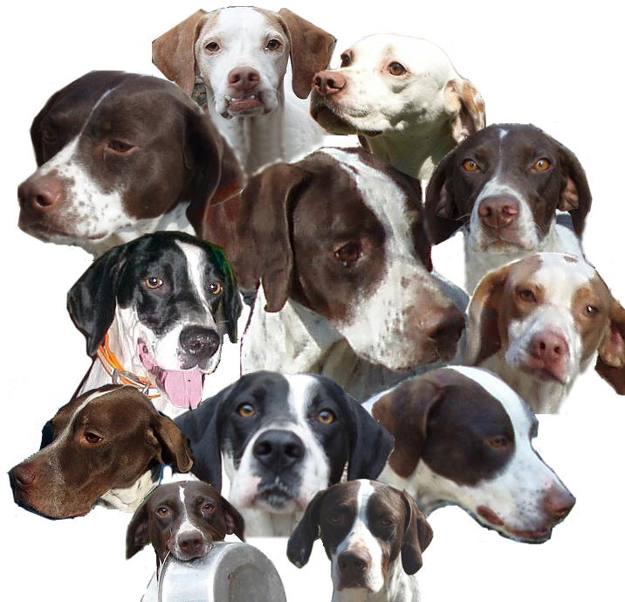
UNIT 8: EVERYTHING VARIES

Slide 3
Homepage Unit 8: Everything Varies
Click on underlined text to go to information and exercises!
Materials List
Introduction
Exercise 1: Recognizing Individuals as Unique
Exercise 2: Leaf Match
Exercise 3: Using Mathematics to Describe a Population
Exercise 4: Simple Shell Match
Exercise 5: Making Sense of Variation: The Matching Game
Exercise 6: Finding Species
Exercise 7: Mystery Shell
Exercise 8: Mechanisms Underlying Variation
Guide to Leaves in Unit 8
Guide to Shells in Unit 8
Guide to Snail Shells in Unit 8, Exercise 8
SUGGESTED READING
LINKS
Clicking the icon on other slides will bring you back to this page!

Slide 4
Unit 8: Everything Varies – Materials List
Container A, which contains
35 unique Leaves
Container B, which contains
30 leaves of species A
30 leaves of species B
Container C, which contains
30 mollusk shells with red dot on each
Container D, which contains
30 mollusk shells with blue dot on each
Container E, which contains
A “mystery shell”
Bag containing
6 individual bags, each with
10 assorted snail shells
6 rulers
6 protractors
1 container with a cloth bag of beads of 2 colors
4

Slide 5
Introduction
There are approximately 1.8 million named species.
However, scientists estimate that the Earth may actually be home to over 10 million species.
Why are there so many different kinds of living things? Or, to put it another way, why is there so much variety?
Earth has a lot of geological variation, that is, it has many different types of physical structures.
Also, the Earth’s shape and the way it orbits the sun create variation in Earth’s climate.
Climatic and geographical variability create a variety of habitats, or homes, in which organisms can live.
Organisms vary because everything else varies, and each species has adapted traits that help it to survive in the place where it lives.
In this series of exercises, you will explore the variation of life by examining leaves and seashells.
5

Slide 6
In this unit, the student will…
test their memory and powers of observation in learning to identify leaves and shells.
learn how to quantify variation present in samples, as well as how to compare variation between samples.
group items/organisms based on similarities.
learn about how taxonomists divide organisms into species, and about various species concepts.
learn about the sources of variation in various organisms, as well as the importance of variation in various contexts.
6

Slide 7
Exercise 1: Recognizing Individuals as Unique
Locate container A, which holds 35 laminated leaves. Each leaf has a unique number on its back.
Select one leaf from this batch. Carefully examine the upper surface of this leaf (the side without the number) for a few minutes and try to commit its appearance to memory.
After studying the leaf, turn it over and write down the number on its back.
Return the leaves to the container.
The teacher will now mix up the leaves, and spread them leaves face up on a table.
Each student should now try to find his or her ‘special leaf’ without looking at the number on its back.
The teacher will check the number on your leaf to see if it matches the number from the leaf you originally examined.
The teacher should keep a tally of the number of students that were successful in finding their leaves.
7

Slide 8
Exercise 1: Recognizing Individuals as Unique
8

Slide 9
Exercise 1: Recognizing Individuals as Unique
Next you will make a table to summarize the outcome of this game. This table will help you to decide which traits are the best ones to use when identifying leaves.
Discuss the characteristics that each student used to remember their leaves.
Make a table like the one that follows. If a student used more than one characteristic, use the characteristic that they looked for first when they went up to the table.
Trait | Absolute Frequency | Relative Frequency | Number of Successes | Trait Success Rate
Shape
Size
Color
Leaf Edge
Damage
Venation
9

Slide 10
Exercise 1: Recognizing Individuals as Unique
10

Slide 11
Exercise 1: Recognizing Individuals as Unique
11

Slide 12
Exercise 1: Recognizing Individuals as Unique
Relative frequencies are related to percentages in the following way. If you multiply the decimal number by 100, this would give you the percent equivalent of your decimal number.
Example: 0.393 x 100 = 39.3%
Find the relative frequency of each characteristic for the group of students participating in the activity using the procedure described in the above example.
Once you find the relative frequencies for each characteristic, find the sum of all your relative frequencies. The sum of all your relative frequencies should be very close to 1, or the sum may be exactly 1. (The sum may not be exactly 1 if you rounded some of the decimals as was done in the above example.)
12

Slide 13
Exercise 1: Recognizing Individuals as Unique
Why should the sum be 1, or very close to 1?
When you are working with relative frequencies, 1 indicates 1 whole.
Another way to think about this is to think about the relationship between relative frequency and percentages.
A relative frequency of 1 is equal to 100%.
If you eat 100% of a pizza, you eat the whole pizza.
If you get a 100% on a math test, all of your answers were correct!
Your relative frequencies should have a sum of 1 (or close) to indicate the whole group of students participating in the activity.
13

Slide 14
Exercise 1: Recognizing Individuals as Unique
The relative frequency is a useful statistic because it can be used to compare the outcomes of experiments with different numbers of trials.
For example, suppose Mrs. Brooks’ 5th grade class has 30 students, and Mrs. Tichnour’s class has 20 students.
Both classes take the same science exam. Seven students in Mrs. Brook’s make an A+, while six students in Mrs. Tichnour’s class make an A+.
However, since Mrs. Tichnour’s class had fewer students than Mrs. Brook’s class, this does not necessarily mean that Mrs. Brooks’ class did better on the exam than Mrs. Tichnour’s class.
Q1. Calculate the relative frequency of an A+ in each class. Which class did better on the exam? Click for the answer!
Mrs. Tichnour’s class did better on the exam, (relative frequency of A+’s of 0.3), compared to Mrs. Brooks’ class (0.233)
14

Slide 15
Exercise 1: Recognizing Individuals as Unique
Q2. Which trait(s) yielded the most successes? Are the traits with more successes necessarily the best ones to use when identifying leaves? Why or why not? How could we change the game to make the number of successes that belong to a trait a better measure of how effectively a trait can be used to identify leaves? Click for the answer!
The traits with the most successes are not necessarily the best ones to use when identifying leaves.
For example, these traits may have yielded more successes because they were more often employed, or it could be that some traits work well for certain people but less well for others.
There are many ways that we could alter the game to make the number of successes a better measure of how effectively a trait can be used to identify a leaf. If instead we assigned each trait to an equal number of students then the number of successes that each trait yielded would be a better measure of how effective the trait can be used to identify leaves.
15

Slide 16
Exercise 1: Recognizing Individuals as Unique
16

Slide 17
Exercise 1: Recognizing Individuals as Unique
Q3. Which trait(s) yielded the highest success rates? Are the traits with higher success rates necessarily the best ones to use when identifying leaves? Why or why not? How could we change the game to make the trait success rate a better measure of how effectively a trait can be used to identify leaves?
The traits with the highest success rates are not necessarily the best ones to use when identifying leaves. If a trait was employed by a single person, and that person was successful at identifying their leaf then the trait’s success rate would be a perfect 100%. However, it could be that the trait is only effective at identifying that one particular leaf, or that the person was just very good at using that trait. There are many ways that we could alter the game to make the success rate a better measure of how effectively a trait can be used to identify a leaf. For example, we could add more leaves and require each student to identify multiple leaves.
17

Slide 18
Exercise 1: Recognizing Individuals as Unique
You are now going to use the data your teacher collected to make a bar graph indicating the leaf characteristics students used to remember their leaves.
Your bar graph will display a visual comparison of the data which should be understood by anyone who might look at the graph. For example, someone should be able to look at the graph and be able to answer the following questions:
Which characteristics were used by more students to find their leaves?
Which characteristics were not used by many students?
18

Slide 19
Exercise 1: Recognizing Individuals as Unique
Now, you should answer the following questions, based on your class data:
Which characteristic was used by the most students?
How many students used that characteristic to find their leaves?
You will use this number to determine the range of your vertical scale for your graph.
Your vertical scale will begin at 0 and increase at equal intervals as you go up the vertical axis. Your largest number will be greater than or equal to the number of students in the group of the ‘most-used’ characteristic.
19

Slide 20
Exercise 1: Recognizing Individuals as Unique
Determine your interval size so that your graph clearly displays the data and the related labeling.
For example, suppose 17 students used leaf shape as the primary characteristic to find their leaves.
You might decide to count by 2’s on your vertical scale, and since the largest number you need to show is 17, your last number on the vertical scale might be 18.
There is really no need to go much beyond 18 on the graph since your largest number is 17.
If the largest number you need to show is 18 and you are using an interval of 2, you can stop at 18 or you might go one interval beyond 18 and stop at 20.
Whatever interval you choose, be sure your graph is large enough to clearly indicate comparisons of your data, but also fit on your paper.
20

Slide 21
Exercise 1: Recognizing Individuals as Unique
You will also make a second graph using the same data set, but this time comparing relative frequencies of students using certain characteristics rather than the numbers of students.
Using the relative frequency data you have just found, construct a bar graph. The primary difference from your first graph will be your vertical scale, which will indicate relative frequencies rather than numbers of students as in your first graph.
What was the largest relative frequency of any one characteristic? That largest relative frequency tells you how far up your vertical scale should go. For example, if your largest percentage is 0.393, you will not need to go any higher (or much higher) than that number on your vertical scale (Example: if your interval is 0.10, then you might stop at 0.40 if the largest relative frequency is 0.393).
Determine your intervals for your vertical scale so that your graph is large enough to clearly indicate comparisons of your data, but also fit on your paper.
21

Slide 22
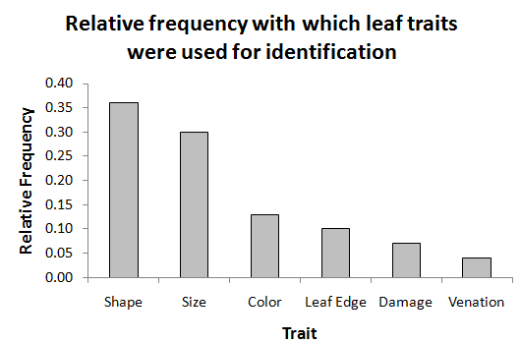
Exercise 1: Recognizing Individuals as Unique
Below is an example of what a graph of relative frequencies of correct identification of leaves using particular traits might look like:
22

Slide 23
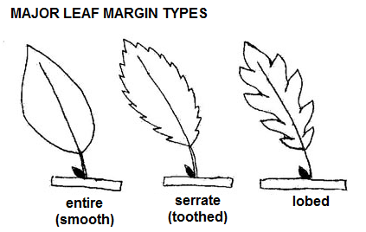
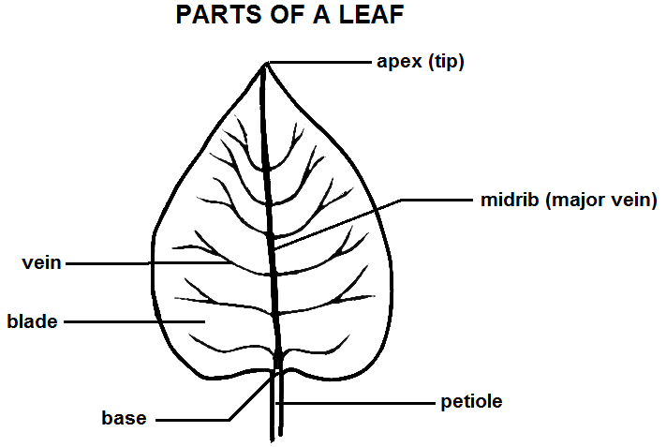
Exercise 1: Recognizing Individuals as Unique
Look at the images below to identify other leaf traits that might vary among species and individuals.
Have each student pick a new leaf and play the game again.
Calculate the new class success rate to see if it increased.
23

Slide 24
Exercise 2: Leaf Match
In this exercise, you will use all of the leaves in Container A, and try to identify them by trying to match them with pictures of leaves.
Below each picture you will find the common name and the scientific name of the tree species from which the leaf came.
The scientific name consists of two parts: the genus (close relatives will all have this name) and the species (only individual trees that might possibly interbreed share this name).
On a separate sheet of paper, write the numbers 1-35. When you examine a particular leaf, note its number, and write the name of the tree species to which you think that leaf belongs beside that number on your answer sheet. See if you can identify the species of tree from which each leaf came.
Your teacher may wish to take a tally of student answers to see if there is a consensus, or if there is disagreement about the identification of particular leaves. If there is any disagreement on a particular leaf, you may wish to use a field guide/the internet to see if a consensus can be reached.
24

Slide 25
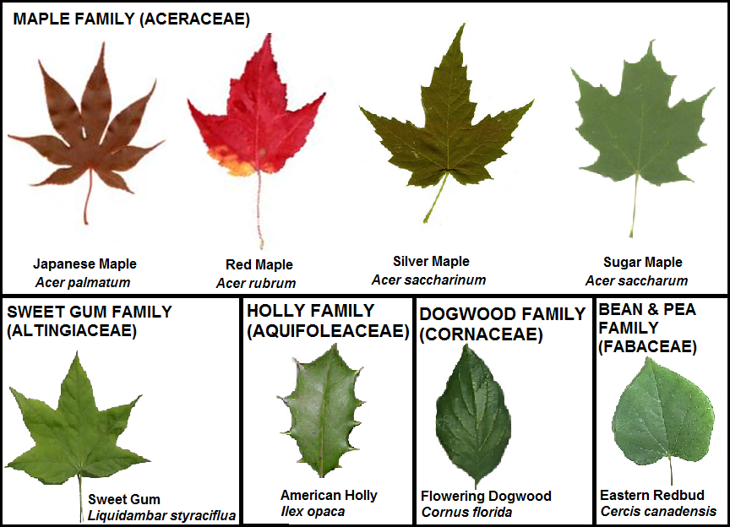
Guide to Leaves in Unit 8
25

Slide 26
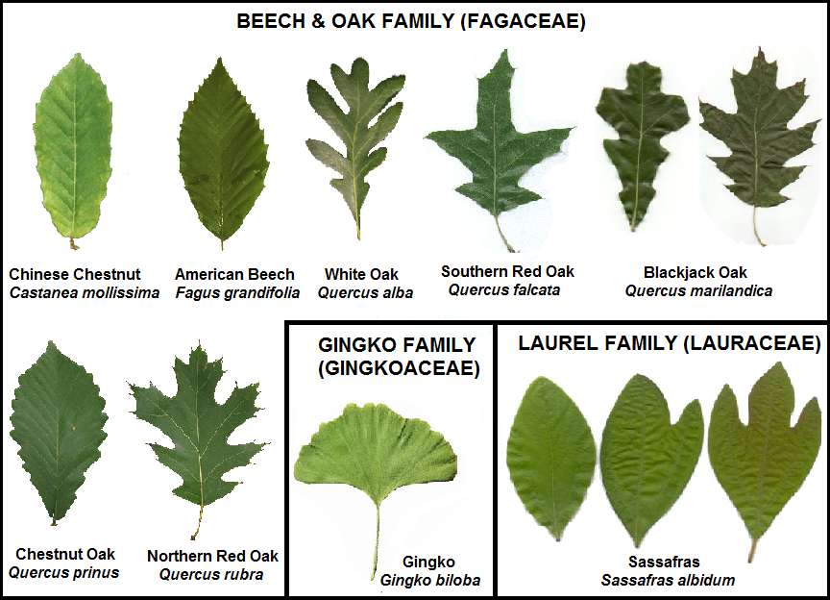
Guide to Leaves in Unit 8
26

Slide 27
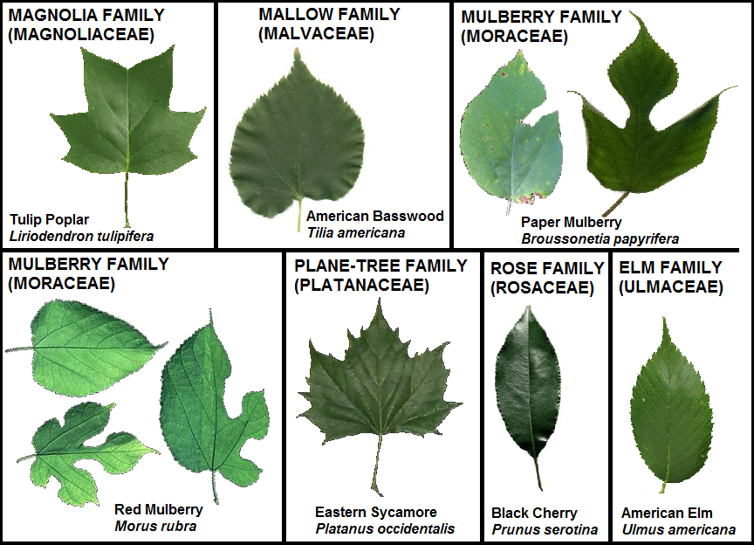
Guide to Leaves in Unit 8
27

Slide 28
Exercise 3: Using Mathematics to Describe a Population
When scientists study populations, they are typically interested in knowing several parameters, or characteristics of those populations, such as the “most typical” value of a trait, or the amount of variation present in the populations.
One way to examine these parameters would be to measure or categorize every individual in the populations.
Unfortunately many populations are so large, or difficult to access, that it would be impossible to examine and describe each individual in the population.
For example, imagine trying to measure the length of every ant in an ant hill, or the weight of every cardinal that passes through your yard.
28

Slide 29
Exercise 3: Using Mathematics to Describe a Population
Since scientists often can’t examine every individual in a population, they often must settle for examining a sample, or subset of the population.
Then, the traits of individuals in the sample can be described by numbers or categories, and this information used to calculate statistics that summarize the data.
These sample statistics serve as estimates of population parameters.
When using sample statistics to make inferences about a population, they make a very important assumption.
They assume that the sample is representative of the population as a whole.
In order for this assumption to be valid, scientists must be very careful when they select the sample individuals.
29

Slide 30
Exercise 3: Using Mathematics to Describe a Population
See if you can answer the following questions:
Q1. Suppose that you wanted to find out what brand of pants are most often worn by fifth grade boys in a small town. Which of the following samples do you think would best answer this question? Why? What is wrong with the other samples?
The boys in Mrs. Brooke’s fifth grade class
The boys whose last names begin with the letters A-D or M-P.
The boys that ride bus 23
The boys that sit together in the far right corner of the cafeteria
CLICK TO GO TO THE NEXT SLIDE FOR THE ANSWER!
30

Slide 31
Exercise 3: Using Mathematics to Describe a Population
Sample b is probably the best sample to use when answering this question, because the boys in sample b are not likely to be linked in ways that affect the brand of pants that they wear.
The boys in sample a, c, and d, see each other every day and so they might influence each other.
The boys in sample c live in the same neighborhood and so they probably belong to the same socio-economic class, thus their parents may shop for the same brand of pants.
The boys in sample d are likely friends and so they may be similar in many additional ways that might cause them to prefer the same brand of pants.
31

Slide 32
Exercise 3: Using Mathematics to Describe a Population
Q2. What if instead you wanted to know the average height of a fifth grade boy? Could any of the samples that you rejected before be used to answer this new question?
The boys in Mrs. Brooke’s fifth grade class
The boys whose last names begin with the letters A-D or M-P.
The boys that ride bus 23
The boys that sit together in the far right corner of the cafeteria
CLICK FOR THE ANSWER!
Sample a or b could be used to answer this question. We probably shouldn’t use sample c or d because these boys likely belong to the same socio-economic class, and so they may have similar diets, which in turn affects their growth.
32

Slide 33
Exercise 3: Using Mathematics to Describe a Population
Leaf widths (cm)
3
3
3
5
5
5
5
5
5
5
5
5
5
6
6
6
6
8
8
9
9
9
9
9
9
9
9
9
9
19
In the following exercises, you will examine leaves, and use these leaves to help you understand how sample statistics are calculated, and how these statistics are used to describe populations.
Decide, as a class, a particular trait to measure on your leaves, for example, leaf blade length, greatest blade width, leaf area (estimated as the product of blade length and greatest blade width), etc.
Each student should select a leaf from Container A, and take the measurement chosen above, rounding their measurement to the nearest centimeter (or cm² in the case of area), and record their measurement on the board.
After all students have measured their leaves, you should record all of these values in an ordered list, from smallest to largest, like the example to the right.
33

Slide 34
Exercise 3: Using Mathematics to Describe a Population
Click HERE to go to Exercise 3a, where students in grades 4-12 can learn how to calculate measures of central tendency.
Click HERE to go to Exercise 3a.2, where students in grades 9-12 will learn about sigma notation.
Click HERE to go to Exercise 3b, where students in grades 5-12 will learn how to calculate measures of spread.
Click HERE for a mini-challenge on estimating square roots.
Click HERE to go to Exercise 3b.2, where students in grades 9-12 will conduct a simulation that illustrates why the formula for sample variance is different than that for population variance.
Click HERE to go to Exercise 3c, where students in grades 5-12 will learn about graphically visualizing measures of central tendency & spread.
Click HERE to go to Exercise 3d, where students in grades 9-12 will learn about how statistical tests can be used to compare populations.
34

Slide 35
Exercise 3a: Measures of Central Tendency
Trait values vary between individuals, but in a sample of individuals, some values are more typical than others.
For instance, in the fall when leaves are changing colors, some trees, such as willows, have leaves that are primarily yellow in color, while other trees, such as oaks, have leaves that are primarily brown in color.
According to our visual observations, these are the most common leaf colors for willows and oaks in the fall. However, someone else might disagree and say that oak leaves are primarily red in the fall.
Based on observation alone, there’s no way to know for certain who is correct.
If, however, we can measure the value of a trait, then we can assign a numerical value to each individual in our sample and use mathematical statistics called measures of central tendency, to decide which value is the most typical.
35

Slide 36
Exercise 3a: Measures of Central Tendency
Leaf widths (cm)
3
3
3
5
5
5
5
5
5
5
5
5
5
6
6
6
6
8
8
9
9
9
9
9
9
9
9
9
9
19
36

Slide 37
Exercise 3a: Measures of Central Tendency
After you have found the median of your sample data, now draw a table with two columns. Label the first column ‘Values Observed’ and the second column ‘Number of Observations’.
In the first column list the values that appear in your ordered list from least to greatest, eliminating any repeat values. In the second column list the number of times that each value from the first column appears in your ordered list. Title your table appropriately. See the example at right.
Now you are ready to find the mode of your data set. The mode is another measure of central tendency, and is the value that appears the most often. There are two modes for the example leaf width data set, because 5 cm and 9 cm both appear 10 times, more times than any other values.
Observed leaf widths
Value | Absolute Frequency
3 | 3
5 | 10
6 | 4
8 | 2
9 | 10
19 | 1
37

Slide 38
Exercise 3a: Measures of Central Tendency
38

Slide 39
Exercise 3a: Measures of Central Tendency
The mean, like the mode and the median, is also a measure of central tendency.
Since there are multiple measures of central tendency, it is up to you to decide which measure (the median, the mode, or the mean) best represents the most typical trait value.
In the example leaf width data set, the modes are probably the best measure of central tendency because over half of the leaves in this sample have leaf widths that are equal to one of the two modes.
On the next slide are two other example data sets.
Compute the mean, median, and mode for each set. Then try to answer the following question:
Which measure of central tendency best describes each data set, and why?
39

Slide 40
Exercise 3a: Measures of Central Tendency
Data Set A
CLICK FOR THE ANSWERS!
Value | Absolute Frequency
3 | 2
5 | 2
6 | 5
8 | 2
9 | 1
Data Set B
Value | Absolute Frequency
5 | 3
6 | 4
8 | 2
25 | 1
40

Slide 41
Exercise 3a.2: Sigma Notation
41

Slide 42
Exercise 3a.2: Sigma Notation
42

Slide 43
Exercise 3a.2: Sigma Notation
43

Slide 44
Exercise 3a.2: Sigma Notation
44

Slide 45
Exercise 3a.2: Sigma Notation
45

Slide 46
Exercise 3b: Measures of Spread
Leaf widths (cm)
3
3
3
5
5
5
5
5
5
5
5
5
5
6
6
6
6
8
8
9
9
9
9
9
9
9
9
9
9
19
46

Slide 47
Exercise 3b: Measures of Spread
Another measure of spread is the variance.
It is important to note that there are two ways of calculating the variance of a population or sample. They are very similar, with one small exception.
First, let's learn how you would calculate the variance of a population, if the population were sufficiently small enough to gather data on every individual within it. For simplicity, first assume that the "sample" of leaves in Container A actually represents a sample of every individual in the simulated "population".
You are now going to calculate the population variance (usually represented as σ², read as "sigma squared", since the expression uses lower case Greek letter "sigma" squared) for your leaf widths using these leaves. Follow the steps on the next slide to see how the population variance is calculated.
47

Slide 48
Exercise 3b: Measures of Spread
To calculate the population variance (σ²), when you have measured every individual in the population:
First subtract each value from the mean value. If you have 30 data points, you will subtract each of the 30 data points from the mean.
Find the square of each subtraction. For example, if one of your data points was 4 and the mean was 8, you subtract 4 from 8:
8 – 4 = 4
Now square this value (multiply it by itself). For example:
4² = 4 x 4 = 16
Do this same procedure for each of your measurements.
When you have found all your these values, add them all together.
When you have your sum of subtraction values, divide that sum by the total number of measurements (also referred to as N, or the population size).
The result of this division is equal to the population variance.
48

Slide 49
Exercise 3b: Measures of Spread
Leaf widths (cm)
3
3
3
5
5
5
5
5
5
5
5
5
5
6
6
6
6
8
8
9
9
9
9
9
9
9
9
9
9
19
49

Slide 50
Exercise 3b: Measures of Spread
In the previous steps, we computed the population variance, which is used when one can measure every individual within a population.
However, it is almost always impossible for scientists to collect data on every individual within a population, so they usually must settle for collecting data on a sample from that population in order to estimate the typical values and variability within the entire population.
As it turns out, the method of calculating variance as presented earlier is not always a very good estimate of the true population variance if one is using a sample that does not consist of the entire population.
For this reason, calculating the variance of a sample (which is used to estimate the true population variance, which cannot typically be known) is done in a slightly different way.
50

Slide 51
Exercise 3b: Measures of Spread
51

Slide 52
Exercise 3b: Measures of Spread
The standard deviation is another measure of spread.
The standard deviation is simply the square root of the variance.
For example, the population standard deviation (represented by σ, the lower case Greek letter "sigma") is the square root of the population variance σ², and the sample standard deviation (usually represented by s) is the square root of the sample variance s².
For example, both the "population" standard deviation and "sample" standard deviation of the leaf width data from the previous slides are approximately 3 (if rounding to the nearest cm, though the sample variance is actually larger, and likely a better estimate of the true population variance).
Like the range, the variance and the standard deviation are also measures of spread. In particular, they measure how your data is spread about the mean. Larger values of the sample variance and standard deviation indicate more spread in the data.
52

Slide 53
Exercise 3b: Measures of Spread
53

Slide 54
Mini-Challenge: Estimating Square Roots
Look at the three squares below and notice the side lengths that are labeled on the first and last squares.
The first square has a side length of 3, and the last square has a side length of 4.
The areas of all three squares are also labeled. The first square has an area of 9 because 3 x 3 = 9, and the last square has an area of 16 because 4 x 4 = 16.
What will the side lengths be for the middle square if the area of the square is 12?
Remember that the definition of a square tells us all sides must have equal length.
54

Slide 55
Mini-Challenge: Estimating Square Roots
The square in the middle does not have its side length labeled so you are going to determine what the side length must be to have an area of 12.
If you know the smallest square has a side length of 3 and the largest square has a side length of 4, what can you say about the length of the middle square?
How does the size of the middle square relate to the other two squares? Both 3 and 4 are whole numbers, but will the missing number be a whole number? Why, or why not?
55

Slide 56
Mini-Challenge: Estimating Square Roots
How do you think you might find the side length of that middle square?
Use your calculator to help you find the missing side length, but do not use the square root key (that would be cheating!).
Use your estimation skills to help you begin choosing side lengths to test to find the actual side length.
When you believe you have the side length, test your answer by multiplying the number by itself (squaring the number). How close is the square of your number to 12?
Continue testing numbers until you have a number to the hundredths place that gets as close as possible to 12 when squared.
56

Slide 57
Exercise 3b.2: Sample variance vs population variance
In the previous exercise, you learned that there is a slight difference in calculating the variance of a sample versus the variance of a population (which can only be calculated if every individual within the population has been measured).
Remember, the denominator in the equation for sample variance is equal to (n-1), where n is the number of individuals in the sample.
The denominator in the equation for the population variance is equal to N (the total number of individuals in the population).
This exercise will illustrate WHY these formulas are different.
57

Slide 58
Exercise 3b.2: Sample variance vs population variance
Your teacher should locate the container marked "Exercise 3b.2," which contains a bag of beads of the same size and shape, but of two different colors.
All of the beads in this bag represent a population, with each bead representing an individual within the population.
Your teacher knows the total number of beads, as well as the number of beads of each color in the bag, but will not reveal this information to the class until you have all conducted the rest of the exercise.
Each color of beads will be assigned a particular value, and your teacher will inform you which color takes which value:
One color of beads will be given a value of 1.
One color of beads will be given a value of 5.
Your teacher should now shake the bag of beads to mix them, and approach one student in the class.
58

Slide 59
Exercise 3b.2: Sample variance vs population variance
That student should reach into the bag, and withdraw a sample of 3 beads (n=3), recording on a piece of paper the color of each, and the value assigned to each of the two colors.
Those beads should be placed back into the bag, and the bag shaken again.
This procedure should be repeated until every student has taken a sample of 3 individuals from the "population".
Each student should now make a table like the one below, and calculate the appropriate values for their sample, rounding their calculated values to the nearest hundredth.
59

Slide 60
Exercise 3b.2: Sample variance vs population variance
After all students have calculated their values for the means and variances (using both methods) for their samples, your teacher should make a table with three columns ("Mean", "Variance Using n", and "Variance Using (n-1)") on the board, and compile students' results.
After all students' results are compiled on the board, you should calculate the average variance for all samples when using both methods (n versus n-1 in the denominator).
Your teacher will now reveal the true population variance (σ²) to the class.
Compare this value to the average sample variances obtained when using both n and (n-1) in the denominator.
60

Slide 61
Exercise 3b.2: Sample variance vs population variance
Now answer the following question:
Q9: What do you notice about the average values of sample variance (s²) using n versus (n-1) in the denominator of the equation when compared to the true population variance (σ²)?
CLICK FOR THE ANSWER!
You should notice that the average sample variance using n in the denominator is smaller than the true population variance. In other words, the use of n in the denominator tends to underestimate the true amount of variance in the whole population. The average sample variance when using (n-1) in the denominator is a much better estimate of the true population variance. This is why the formula for finding sample variance uses (n-1) in the denominator instead of n!
61

Slide 62
Exercise 3b.2: Sample variance vs population variance
Now, look at the values under the "Mean" column on the board.
Using the tally marks representing the number of samples in which each mean was calculated for the samples, and calculate the mean of all of the sample means.
Your teacher will now let you know the true population mean.
Compare the value you calculated as the mean of the class’s sample means to the true population mean (μ), and answer the following questions:
Q10: In effect, what are you doing when you are calculating the mean of all students' sample means?
Q11: Compare your calculated value of the mean of all students' sample means, as well as each of the individual sample means obtained, to the true population mean. Which value is closest to the true population mean? Considering your answer to Q10, what does this tell you?
Go to the next slide for the answers!
62

Slide 63
Exercise 3b.2: Sample variance vs population variance
Q10: In effect, what are you doing when you are calculating the mean of all students' sample means?
CLICK FOR THE ANSWER!
When calculating the mean of all sample means, you are essentially pooling the data from each sample, and calculating the sample mean of a much larger sample size.
63

Slide 64
Exercise 3b.2: Sample variance vs population variance
Q11: Compare your calculated value of the mean of all students' sample means, as well as each of the individual sample means obtained, to the true population mean. Which value is closest to the true population mean? Considering your answer to Q10, what does this tell you? CLICK FOR THE ANSWER!
You should notice that some sample means (of size n=3) are lower, and some are higher, than the true population mean. However, when all of these samples are pooled to make a much larger sample size, the resulting sample mean is much closer to the true population mean. This illustrates the fact that the larger the sample size, the better the sample mean is as an estimate of the true population mean. This also holds true for sample statistics that estimate variation in a population (variance and standard deviation). This is why scientists typically use the largest sample sizes that time &funding allow, as larger sample sizes give them greater confidence that their estimates of characteristics of entire populations are close to their actual values.
64

Slide 65
Exercise 3c: Visualizing measures of central tendency & spread
A relative frequency bar graph can help you to visualize how your data is distributed.
For example, by looking at a bar graph, you can see how spread out the data is, and estimate the central tendency of the data.
You can also use a relative frequency bar graph to find the probability that a data entry belongs to a particular category.
The figure below is a relative frequency bar graph of the sample leaf width data presented earlier in Exercise 3a.
65

Slide 66
Exercise 3c: Visualizing measures of central tendency & spread
In the figure above, the leaf widths are listed along the horizontal or x-axis of the graph.
The relative frequency of each leaf width is plotted along the y-axis.
This data set is bimodal (has two modes) about which the data values are clustered.
We can also see that the relative frequency of 3 cm is 0.1. This means that if we select a leaf at random from our sample, then probability that the leaf’s width is 3 cm is 0.1.
66

Slide 67
Exercise 3c: Visualizing measures of central tendency & spread
Now imagine that we wanted to draw a smooth curve to describe the shape of our data. In the case of the leaf width bar graph the curve might look like the one pictured below.
Often scientists use smooth curves called probability distributions to describe the shape of a bar graph.
67

Slide 68
Exercise 3c: Visualizing measures of central tendency & spread
One type of probability distribution is called a normal distribution.
Normal distributions are very important because, as the name implies, they are considered to be the most standard type of distribution.
When scientists examine data, one of the first questions they ask is whether the data are normally distributed. Below is a plot of several normal distributions. Note that although these distributions vary, they all have the same basic shape.
68

Slide 69
Exercise 3c: Visualizing measures of central tendency & spread
Q12: The figure above shows three data sets that are normally distributed. How do their distributions differ? Do they have the same mean? Do they have the same variance? Which distribution has the greatest mean? Which distribution has the smallest variance?
GO TO THE NEXT SLIDE FOR THE ANSWER!
69

Slide 70
Exercise 3c: Visualizing measures of central tendency & spread
Q12: The figure above shows three data sets that are normally distributed. How do their distributions differ? Do they have the same mean? Do they have the same variance? Which distribution has the greatest mean? Which distribution has the smallest variance?
CLICK FOR THE ANSWER!
The green distribution has the greatest mean, and the blue distribution has the smallest variance.
70

Slide 71
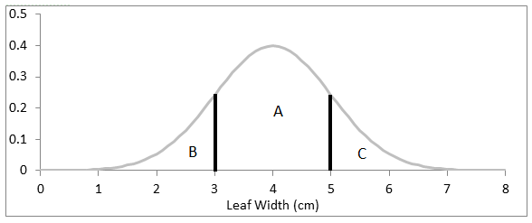
Exercise 3c: Visualizing measures of central tendency & spread
Probability distributions can also be used to find the probability that an individual has a range of trait values.
The probability that an individual’s trait value falls within an interval is equal to the area of the region bounded by the interval on the x-axis and the probability distribution curve. For example, assume that a trait is distributed according as in the figure below.
The probability that an individual in the population has a trait value between 3 and 5 is equal to the area bounded by the two black line segments and the gray probability distribution curve (region A).
71

Slide 72
Exercise 3c: Visualizing measures of central tendency & spread
Probability distributions can also be used to find the probability that an individual has a range of trait values.
The probability that an individual’s trait value falls within an interval is equal to the area of the region bounded by the interval on the x-axis and the probability distribution curve. For example, assume that a trait is distributed according as in the figure below.
The probability that an individual in the population has a trait value between 3 and 5 is equal to the area bounded by the two black line segments and the gray probability distribution curve (region A).
72

Slide 73
Exercise 3c: Visualizing measures of central tendency & spread
Use the figure above to answer the following questions:
Q13: How can you interpret region C in terms of probabilities?
Q14: Now suppose that we select a leaf at random from the population. Rank the following events from most to least probable.
The leaf’s width is between 0 cm and 3 cm.
The leaf’s width is between 3 cm and 8 cm.
The leaf’s width is between 3 cm and 5 cm.
GO TO THE NEXT SLIDE FOR THE ANSWERS!
73

Slide 74
Exercise 3c: Visualizing measures of central tendency & spread
Q13: How can you interpret region C in terms of probabilities?
The area of the region C represents the probability that a leaf drawn at random will have a leaf width greater than 5 cm.
Q14: Now suppose that we select a leaf at random from the population. Rank the following events from most to least probable.
The leaf’s width is between 0 cm and 3 cm. (2nd most probable)
The leaf’s width is between 3 cm and 8 cm. (most probable)
The leaf’s width is between 3 cm and 5 cm. (least probable)
74

Slide 75
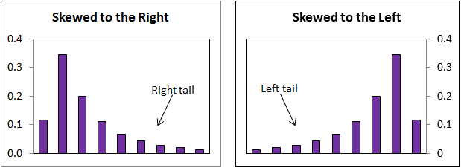
Exercise 3c: Visualizing measures of central tendency & spread
We can also use graphs to see if the data are skewed.
Data are skewed to the right if the right tail of the graph is longer than the left tail of the graph.
Similarly, the data are skewed to the left if the left tail of the graph is longer than the right tail of the graph.
If a data set is normally distributed then it is not skewed, and it has only one mode, which is equal to its mean and its median.
Make a bar graph of your leaf data. Is your graph skewed to the left or the right? Are your data normally distributed?
75

Slide 76
Exercise 3d: Comparing leaves from two samples
Find Container B, which contains two samples of leaves that were collected from two different species of trees or shrubs.
Separate the leaves according to which sample they belong to (species A or species B).
Have each student select one leaf from each sample and measure the selected trait.
For each sample, order the measurements and construct a frequency table as you did in Exercise 3a. Compute the mean, median, mode, range, and variance for both samples and make a double bar graph to help you compare how the different samples are distributed.
76

Slide 77
Exercise 3d: Comparing leaves from two samples
Q15: Examine the figure below. Which species appears to have narrower leaves? Which species appears to have a broader leaf width distribution?
CLICK FOR THE ANSWER!
Species 2 appears to have narrower leaves. Species 1 appears to have a broader leaf width distribution.
77

Slide 78
Exercise 3d: Comparing leaves from two samples
Now use your bar graph to answer the following questions about species A and species B provided in this unit.
Do you think that one of these trees has larger leaves on average? Why or why not?
Do you think that one of these trees has a broader distribution of leaf widths? Why or why not?
Now use your statistics to answer the same questions again. Did your answers change?
Add the samples’ means, medians, and modes to the label of the x-axis of your graph.
78

Slide 79
Exercise 3d: Comparing leaves from two samples
Often scientists compare populations to see if they are different.
In particular, scientists are often interested in comparing the means of two populations.
This is no easy task, because, as we have already mentioned, it is not usually possible to measure a population as a whole.
Usually scientists are only able to measure a sample of the population. So, instead of comparing the population means scientists are forced to compare sample means.
Because samples are incomplete and imperfect representations of the populations from which they are drawn, the sample mean is only an estimate of the population mean.
Therefore, sometimes it happens that two samples may have different means, while the populations from which they were drawn have the same mean.
Alternatively, the sample means may be the same, though the population means may actually be different.
79

Slide 80
Exercise 3d: Comparing leaves from two samples
You are probably already familiar with the scientific definition of the word hypothesis (an “educated guess” based on observations).
In the scientific method, one of the steps is to evaluate or test one’s hypothesis.
One way that scientists do this is with statistical tests, which provide support to (or sometimes fail to support) their hypotheses.
When testing these hypotheses statistically, however, one is actually comparing two different-statistical hypotheses: the null hypothesis and the alternative hypothesis.
However, it is important to note that statistical hypotheses are still slightly different from scientific hypotheses in that statistical hypotheses simply examine whether there is a difference between groups, or a pattern relating particular variables, but not the WHY behind them.
80

Slide 81
Exercise 3d: Comparing leaves from two samples
Let’s say, for example, that you think there is a difference in average height of American high school baseball players and high school soccer players.
The alternative hypothesis (often represented as H_{A} or H₁) is simply the original hypothesis formulated by the scientist.
For example, there is a difference between the average heights of American high school baseball players and high school soccer players. This would be your alternative hypothesis in this case.
The null hypothesis (often represented as H₀) is essentially a hypothesis that is one that opposes your alternative hypothesis.
In our example, the null hypothesis in this case would be that there is NO difference in the average heights of American high school baseball players and high school soccer players.
81

Slide 82
Exercise 3d: Comparing leaves from two samples
Null and alternative hypotheses can also have directionality. For example, if you think that baseball players are TALLER than soccer players, the hypotheses you would be testing would be as follows:
H₀: American high school baseball players are shorter than, or equal in height to American high school soccer players on average.
H_{A}: American high school baseball players are taller than American high school soccer players on average.
As already mentioned, the populations of interest in this example are way too large for you to measure the height of every player.
So, you could collect data (ideally by randomly sampling) the populations. For example, you could travel to randomly determined high schools, and measure as many randomly selected players as time and money would allow. You would then have a set of sample data, which you could use to statistically test your hypothesis.
82

Slide 83
Exercise 3d: Comparing leaves from two samples
In conducting statistical hypothesis tests, it is important to realize that what you are doing, ALWAYS, is really testing, based on the sample data, whether you should reject or “fail to reject” the NULL HYPOTHESIS.
Scientists prefer to say that they “fail to reject” a null hypothesis when doing so is supported by their data, rather than saying they “accept” it, as accepting it implies that the null hypothesis is completely true.
However, they know that this very well may not be the case. The null hypothesis may be false, but they may not have enough data to conclusively show that it is false!)
There are many different types of statistical tests, each of which are used for various types of data, but they all follow the same basic idea.
The next slide provides an overview of the general procedure for all statistical tests.
83

Slide 84
Exercise 3d: Comparing leaves from two samples
General steps of all statistical tests:
Data are used to calculate a test-statistic.
The test-statistic is compared to a critical value (which depends on the size of the sample, as well as the degree of confidence one wishes to have regarding their decision).
The null hypothesis is either rejected or fails to be rejected, based on the comparison of the test statistic to the critical value.
84

Slide 85
Exercise 3d: Comparing leaves from two samples
So, how do scientists make informed decisions on population means based only on sample means?
Such decisions are based around the concept of significance.
In other words, if two sample means are different, how likely is it that the difference between those sample means actually reflects a difference in the means of the entire populations in question?
Let’s return to our example of the average heights of American high school baseball players and American high school soccer players, but first let’s talk a little bit about the types of errors that can be made in statistical tests.
85

Slide 86
Exercise 3d: Comparing leaves from two samples
Remember, very often in science, it is impossible to be 100% certain about populations in which we are interested, simply because we cannot measure every individual in the populations. Because of this, there are two different types of errors that we could make based on our data:
We could incorrectly reject the null hypothesis when it is true. This is called a Type I error.
We could incorrectly fail to reject the null hypothesis when it is false, which is known as a Type II error.
86

Slide 87
Exercise 3d: Comparing leaves from two samples
Remember, these are the types of errors one can make when conducting statistical tests:
Type I error: Incorrectly rejecting a true H₀.
Type II error: incorrectly failing to reject a true H₀.
Dealing with Type II errors is easily solved by gathering as much data as possible.
If our sample sizes are large, we are more likely to detect real differences that exist between populations based on our samples.
But, how do we deal with Type I errors?
In other words, how do we keep from failing to reject a null hypothesis that is actually true?
87

Slide 88
Exercise 3d: Comparing leaves from two samples
Review of types of statistical errors:
Type I errors: Incorrectly rejecting a true H₀.
Type II error incorrectly failing to reject a true H₀.
Scientists deal with Type I errors by deciding how sure they want to be (usually 95%, sometimes 99%; remember, we can never have 100% certainty!) that they are correct in their decision to reject the null hypothesis.
The value representing the remaining margin of uncertainty (5% or 1%, usually represented in decimal forms as probabilities of 0.05 or 0.01) is known as the significance level of the test.
This is directly related to our earlier discussion of the meaning of significance, in that the more certain we wish to be that our decision to reject the null hypothesis is correct, the larger the differences between our samples from the populations of interest (relative to the variances) have to be in order for them to be considered significant.
88

Slide 89
Exercise 3d: Comparing leaves from two samples
If you find that, in your samples, the baseball players are an average of ¼” taller, is this really significant?
Such a small difference may be accounted for by some of the soccer players slouching while being measured, or differences in the thickness of the soles of shoes of any of the players.
Such a small difference could also be a matter of error in your measurements, as perhaps not all of your measurements were done exactly the same way.
Thus, chance or error could account for such a small difference, and baseball players may not really be taller than soccer players after all!
However, if your sample means indicated that baseball players are 6” taller than soccer players, this difference is likely to be a real one, because such a difference is likely too large to be accounted for by chance or error.
89

Slide 90
Exercise 3d: Comparing leaves from two samples
Just how large does a difference between sample means have to be to be significant?
Well, this depends on how confident we want to be when making statements about the population means, based on our sample means, as well as the sizes of our samples.
It is important to note that in science, one can never be 100% confident in the conclusions drawn from characteristics of samples.
The only way we can be 100% confident about differences between the means of two different populations would be to measure the value of interest on every single individual in each of the populations we wish to compare, which is often impossible due to limitations of time, money, etc.
90

Slide 91
Exercise 3d: Comparing leaves from two samples
Let’s return to our baseball/soccer player example. If the difference in sample mean heights was very small, our confidence to say that the population mean heights are different is lower than it would be if the difference in sample mean heights was fairly large.
Also, let’s say we only measured 10 baseball players and 10 soccer players. Those are fairly small samples.
What if the baseball sample, just by chance, contained 2 boys much taller than the average baseball player, or our soccer sample contained a much shorter than average player?
Either of these increases the chances that our results are not significant. However, if we measured 100 players of each sport and obtained the same difference in sample means, we would be more confident that such a height difference is significant.
Nevertheless, the greater the difference between sample means, the more likely the population means are also different!
91

Slide 92
Exercise 3d: Comparing leaves from two samples
However, the significance of the difference between sample means also depends on the variance of the samples.
In general, the larger the sample variances, the less likely it is that the difference in the sample means is significant.
In order to understand how the variance affects the significance of the difference in the means, we will look at an example.
92

Slide 93
Exercise 3d: Comparing leaves from two samples
Suppose that a scientist is studying how leaf width varies with rainfall in two plant species, fire bushes (FB) & maple trees (MT).
He collects four sets of leaf samples representing the two species, each found at the same two localities that differ in annual rainfall.
Both localities were suburban yards, but locality 1 (L1 in east TN) receives 48 inches of rainfall a year and locality 2 (L2 in Fort Lauderdale, FL), 64 inches of rainfall per year.
Q17: Assuming that a large number of leaves were collected from all of the trees at the respective localities, which of the following best describes the population to which MTL1 belongs?
All of the maple leaves in North America
All of the maple leaves from suburban yards
All of the maple leaves found at the locality L1
All of the maple leaves that receive approximately 48 inches of rainfall a year
CLICK FOR THE ANSWER!
93

Slide 94
Exercise 3d: Comparing leaves from two samples
Look at Figures 9 and 10. Figure 9 shows the distribution of leaf widths in samples FBL1 and FBL2. Figure 10 shows the distribution of leaf widths in samples MTL1 and MTL2.
Populations represented by these samples are normally distributed.
Also, the populations from which FBL1 & FBL2 were taken have the same variance, as do the populations from which MTL1 and MTL2 were taken.
94

Slide 95
Exercise 3d: Comparing leaves from two samples
Use Figures 9 and 10 and your knowledge of normal distributions to answer the following questions.
Q18: What are the means of FBL1, FBL2, MTL1, and MTL2?
CLICK FOR THE ANSWER!
FBL1: Mean = 4; FBL2: Mean = 3; MTL1: Mean = 8; MTL2: Mean = 9
95

Slide 96
Exercise 3d: Comparing leaves from two samples
Q19: What is the difference between the means of FBL1 &FBL2 (FBL2-FBL1)? What is difference between the means of MTL1 &MTL2 (MTL2-MTL1)?
CLICK FOR THE ANSWER!
The difference between the means of FBL1 & FBL2 is equal to 1. The difference between the means of MTL1 & MTL2 is also 1.
96

Slide 97
Exercise 3d: Comparing leaves from two samples
Q20: Compare the x-axis of Figure 9 to the x-axis of Figure 10. Which difference appears to be more significant, the difference between the means of FBL1 and FBL2 along the x-axis of Figure 9, or the difference between the means of MTL1 and MTL2 along the x-axis of Figure 10? Explain your choice.
GO TO THE NEXT SLIDE FOR THE ANSWER!
97

Slide 98
Exercise 3d: Comparing leaves from two samples
In these figures, the difference between the means of MTL1 & MTL2 appears to be more significant because the distance between the mean of FBL1 and the mean of FBL2 is longer than the distance between the mean of MTL1 and the mean of MTL2. However, this may not necessarily be true. Go on to the next questions to further explore the significance of the differences.
98

Slide 99
Exercise 3d: Comparing leaves from two samples
Q21: Thinking about the influence of variance on the significance of the difference between sample means, what is another method, using a ruler, you could use to evaluate the significance of the differences in the comparisons in Figures 9 &10? (HINT: Think about the differences between sample means relative to the variances!) GO TO THE NEXT SLIDE FOR THE ANSWER!
99

Slide 100
Exercise 3d: Comparing leaves from two samples
Q21: Thinking about the influence of variance on the significance of the difference between sample means, what is another method, using a ruler, you could use to evaluate the significance of the differences in the comparisons in Figures 9 &10? (HINT: Think about the differences between sample means relative to the variances!) GO TO THE NEXT SLIDE FOR THE ANSWER!
100

Slide 101
Exercise 3d: Comparing leaves from two samples
Q21: Thinking about the influence of variance on the significance of the difference between sample means, what is another method, using a ruler, you could use to evaluate the significance of the differences in the comparisons in Figures 9 &10? (HINT: Think about the differences between sample means relative to the sample variances!)
CLICK FOR THE ANSWER!
Using a ruler, you could measure the distances between the sample means in each figure.
However, keeping in mind the importance of sample variances (reflected by the total span of the x-axis in each figure), you would also want to measure the length of the x-axis in each figure, and calculate the proportion of the x-axis that is taken up by the distance between means in each figure.
The greater this value, the greater the significance of the difference between the means compared in that particular figure.
101

Slide 102
Exercise 3d: Comparing leaves from two samples
Q22: Using the method you came up with in the previous question, which comparison of sample means (FBL1 vs FBL2 or MTL1 vs MTL2) appears to be more significant? Why?
CLICK FOR THE ANSWER!
Using the method from the previous question, you should see that the difference between the means of FBL1 and FBL2 takes up a greater proportion of the x-axis in Figure 9 than does the distance between the means of MTL1 and MTL2 relative to the x-axis in Figure 10.
This means that the difference between the means of FBL1 and FBL2 is more significant than the difference between the means of MTL1 and MTL2, even though the magnitude of these differences is the same.
In other words, for a given difference between means, the lower the variance, the greater the significance of the comparison.
102

Slide 103
Comparing population means: the t-test
In this exercise, you will actually use a statistical test, known as the t-test, to compare the average values of particular leaf traits of two different species of trees.
You will be using data that you collect yourself, as well as calculating the test-statistic, and using this to help you make a decision regarding the appropriate null and alternative hypotheses.
The t-test is frequently used to compare sample means to determine if the population means are likely to be different.
103

Slide 104
How the t-test works
The t-test uses the sample means to determine if the population means are likely to be different. It works if the following statements are true:
The populations from which the samples were drawn are normally distributed.
Remember, the larger a sample size, the more likely it is to have an approximately normal distribution. Therefore, this is why it’s always a good thing to make your sample sizes as large as feasibly possible!
The populations from which the samples were drawn have the same variance.
This is usually not a problem if the sample sizes are the same, or very close. This makes it important to have equal, or nearly equal sample sizes, in order for the t-test to be an appropriate one for your data!
104

Slide 105
How the t-test works
When we perform the t-test we are essentially testing the following null hypothesis:
H₀: The populations from which the samples were drawn have the same mean.
This is the hypothesis that we are testing, so at the beginning of the experiment, we don’t know if it is true.
105

Slide 106
How the t-test works
Suppose two populations are normally distributed with the same mean and variance.
Imagine that instead of sampling the populations just once, we sampled them thousands of times, & recorded the difference between the means each time (rounded to the nearest 0.5 cm).
From these data, we made the relative frequency bar graph pictured below. This graph can be used to estimate the probability that the difference between sample means falls into a given range.
For example, the probability that the difference between sample means is between 0.5 and 1.5 is about 0.24.
106

Slide 107
How the t-test works
Use the graph below to answer the following questions:
Q23: What is the most likely value of the difference between sample means? Does this make sense? Why?
CLICK FOR THE ANSWER!
The sample difference is most likely to be close to zero. Since the populations from which the samples were drawn have the same mean, it makes sense that the samples are most likely to have similar means (with zero being the most likely value of the difference).
107

Slide 108
How the t-test works
Q24: Estimate the probability that the difference between the sample means is greater than 2.5 cm. Is this event likely?
CLICK FOR THE ANSWER!
The probability that the difference in the sample means is greater than 2.5 is less than 0.01. This event is very unlikely.
108

Slide 109
How the t-test works
Q25: Suppose that you sample two normally distributed populations with the same variance as the populations that we used to make the graph below. After computing the sample means you find that the difference between them is 3 cm. Do you think that these populations have the same mean? Why or why not?
CLICK FOR THE ANSWER!
These populations probably have different means because if they have the same mean, then the probability of drawing samples with such different means is very small, less than 0.01.
109

Slide 110
How the t-test works
The t-test works in the same way as the previous illustration, only there is no need to sample the populations thousands of times and create a relative frequency bar graph because the assumptions of the t-test determine the probability distribution that the difference in the sample means should follow.
The shape of this probability distribution depends on the population variances.
In particular, the difference in the means is more likely to be large for populations with larger variances.
In order to eliminate the dependence of the probability distribution on the variances, we divide the difference in the means by a measure of the variances.
This new quantity is called the t-statistic, and its probability distribution is called a student’s t distribution.
The t-statistic may be positive or negative, but the larger its magnitude, the more likely it is that the difference between the means is significant.
110

Slide 111
How the t-test works
111

Slide 112
How to compute the t-statistic
112

Slide 113
How to compute the t-statistic
113

Slide 114
How to compute the t-statistic
114

Slide 115
How to compute the t-statistic
Recall that the assumption that the population means are the same is called the null hypothesis.
It is the hypothesis that we are checking.
If the t-statistic is large enough, then we will reject the null hypothesis and conclude that populations have different means.
However, if the t-statistic is not large enough to reject the null hypothesis, we cannot conclude that the populations have the same mean.
In this case, all we can say is that the data do not support the conclusion that the populations have different means.
115

Slide 116
How to compute the t-statistic
116

Slide 117
How to compute the t-statistic
Below is a figure showing several student’s t distributions with varying degrees of freedom. Use this figure to answer the following questions.
Q27: How does the variance of the student’s t distribution change with the degrees of freedom?
CLICK FOR THE ANSWER!
The variance of the student’s t distribution decreases as the degrees of freedom increases.
117

Slide 118
How to compute the t-statistic
Q28: If a t-statistic has a student’s t-distribution with 58 degrees of freedom, how does the probability its absolute value is greater than 3 compare to the probability that its absolute value is less than 3?
CLICK FOR THE ANSWER!
The probability its magnitude is greater than 3 is less than the probability that its magnitude is less than 3.
118

Slide 119
How to compute the t-statistic
Q29: As the sample size increases, what happens to the degrees of freedom? Remember, the number of degrees of freedom is equal to (n_{A} + n_{B} – 2)
CLICK FOR THE ANSWER!
As the sample size increases the degrees of freedom increases.
119

Slide 120
How to compute the t-statistic
Q30: How does the probability that the absolute value of the t-statistic is bigger than 3 change as the sample size gets bigger? Does this make sense? Why or why not?
CLICK FOR THE ANSWER!
The probability that the t-statistic’s magnitude is > than 3 decreases with increasing sample size. As the sample size increases the sample means approach the population means. Since we assume that the population means are the same this forces the difference of the sample means, and therefore the t-statistic, to be closer to zero.
120

Slide 121
How to compute the t-statistic
121

Slide 122
Exercise 4: Simple Shell Match
In this exercise, you will use the shells from containers C (red dot) and D (blue dot).
The object of this game is to see if you can match each of the shells in these containers to pictures of various types of shells.
To go to the pictures of possible shells in Container C:
To go to the pictures of possible shells in Container D:
122

Slide 123
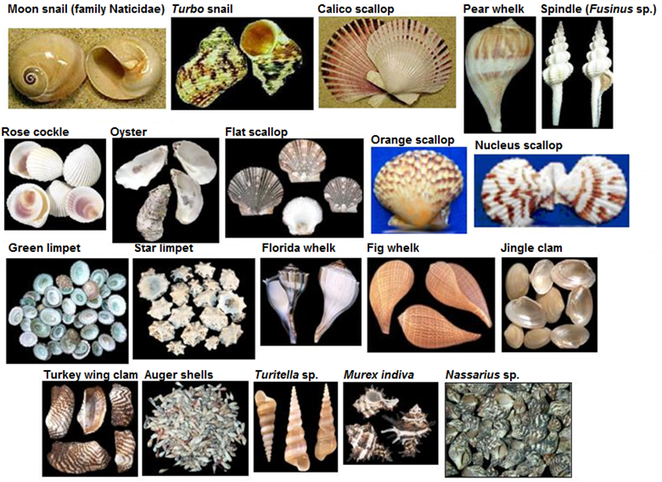
Shells from Container C
123

Slide 124
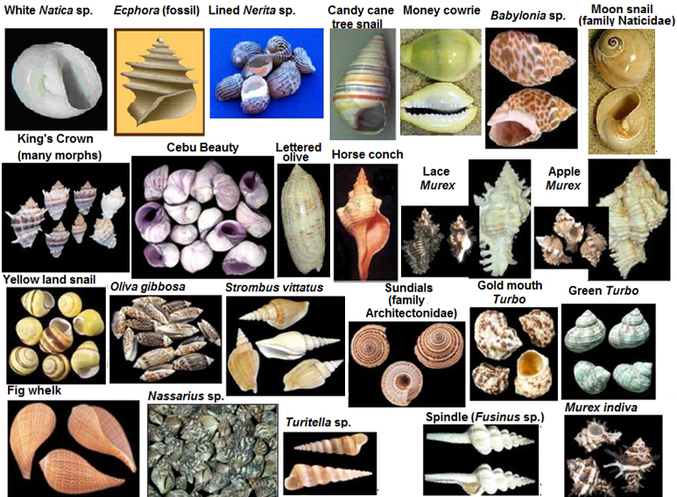
Shells from Container C
124

Slide 125
Exercise 5: Making Sense of Variation: The Matching Game
Mollusk shells come in an amazing variety of shapes, patterns and colors.
There are about 100,000 species of mollusks, and many of these species have their own special shell.
Although every shell is unique, individual shells may have some characteristics in common.
We can sort shells by the characteristics they share, just as we sort the dishes in our kitchens. This exercise and the next demonstrate how biologists group organisms based on the characteristics they share.
Check to see that each shell in Container C has a red dot on it. There should be a total of 30 shells in this container.
Become familiar with the parts of a shell and the various shell types, textures, projections, and color patterns by studying Figures 1 & 2 on the next slides.
125

Slide 126
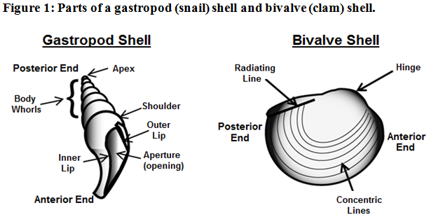
Exercise 5: Making Sense of Variation: The Matching Game
126

Slide 127
Exercise 5: Making Sense of Variation: The Matching Game
127

Slide 128
Exercise 5: Making Sense of Variation: The Matching Game
Choose a shell from container C and examine it carefully.
Now talk with the other students in your class and examine their shells in order to find those shells that most closely resemble your own shell.
Form a group with the students whose shells most closely resemble your own.
Once you have formed a group, devise a group name and write it on two sheets of paper.
Identify the key characteristics that all of the shells in your group share, and record them on both sheets of paper.
Find the black number on each shell in your group, and record these numbers on one of the sheets of paper.
Give your shells to your teacher along with the sheet of paper that lists the shell characteristics but does not show the shell numbers.
128

Slide 129
Exercise 5: Making Sense of Variation: The Matching Game
After all groups have turned in their shells and papers, the teacher will give each group a list of descriptive characteristics that was made by a different group.
Now the teacher will spread the shells out on a long table.
Collect all of the shells that have the characteristics from the list that the teacher gave your group.
Record the shells’ numbers on the sheet of paper that the teacher gave your group.
Once all of the groups have finished, one at a time, each group should announce the group name from the top of the sheet of paper that the teacher gave them and then read the list of traits aloud while holding up the matching shells for the class to see. Also they should read the numbers on the shells so that the group that originally compiled the list can compare these numbers to the numbers on their own list.
129

Slide 130
Exercise 5: Making Sense of Variation: The Matching Game
As a class discuss how successful each group was at finding and collecting another group’s shells. If a group was unable to collect all the correct shells, discuss what characteristics could be added to the list to make the task easier.
Consult the answer sheet to Exercise 3 to find the name and type of each shell in container C.
Please check to see that all red dot shells are placed back in Container C.
130

Slide 131
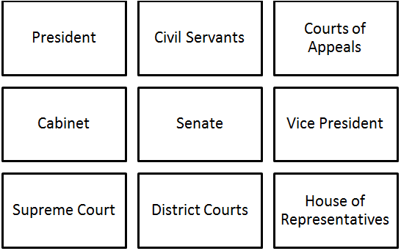
Exercise 6: Finding Species
In this exercise, you will learn about hierarchy and classification.
When scientists classify organisms, they do more than just separate the organisms into groups of like organisms, they also reveal how the organisms are related, or how similar they are.
Suppose, for example that you wanted to classify the officials in our federal government. You might start by assigning government officials to the following groups.
131

Slide 132
Exercise 6: Finding Species
However, the grouping above doesn’t tell us anything about how the government functions, or how these groups are related.
In order to see how these groups of government officials are related, we need to create a tree diagram which shows the classification hierarchy, that is, the criteria by which these groups of officials are classified, and the order in which these criteria are considered.
On the following slide, you will see an example of such a diagram.
132

Slide 133
Exercise 6: Finding Species
The diagram above shows that the government is broken into three separate branches, which are responsible for the three basic tasks of governing.
Then, each branch of government is broken into groups of officials that are charged with specific duties.
That is, government officials are classified first by the branch of government that they belong to, and then by their specific title.
133

Slide 134
Exercise 6: Finding Species
As a second example, we can classify the students in your class by their birth place. In this example, the criteria of classification would be birth country, birth state or province, and then birth city, in that order.
Create a tree diagram to show how the students in your class are classified based on place of birth.
Examine the objects below and create a hierarchy by which to classify them.
Draw a tree diagram to show how the objects are related through your classification hierarchy.
There are many possible responses.
Talk with other students in your class to see how they classified the objects.
134

Slide 135
Exercise 6: Finding Species
The classification hierarchies that we have examined so far are small compared to the hierarchy by which scientists classify life.
The first criteria by which scientists classify life is called the kingdom.
One kingdom is the kingdom Animalia (the animals). This kingdom consists of multicellular organisms that obtain their food by eating other organisms.
The kingdoms are then divided into phyla.
The animal kingdom is divided into approximately 30 phyla, which share similar body plans.
One phylum is the phylum Mollusca (mollusks).
Mollusks are characterized by the presence of a body cavity that contains organs, a mantle cavity that provides gas exchange, and a protective shell.
135

Slide 136
Exercise 6: Finding Species
Each phylum is divided into classes.
There are five classes in the kingdom Mollusca.
The two classes of mollusks used in this exercise are the Gastropoda (snails and their relatives) and the Bivalvia (clams and their relatives).
There are four additional levels of classification below the class level in this hierarchy: order, family, genus and species.
In this exercise, your goal is to play the role of a taxonomists (scientists who focus on classifying living organisms).
In this exercise, you will classify the mollusk shells in Container C and then those in Container D by successively partitioning them into two groups until each group is composed only of shells that are very similar in appearance.
When you are finished, each group of shells that result from your classification hierarchy will represent a species, at least as you define the term.
136

Slide 137
Exercise 6: Finding Species
Spread the shells from container C out onto a long table. All of these shells should have a red dot. (Remove any shells that have a blue dot and return them to container D).
Consult the diagrams on the next slide to see parts and characteristics of shells that you may want to use in your classification.
Can you think of any other criteria by which to classify these shells?
137

Slide 138
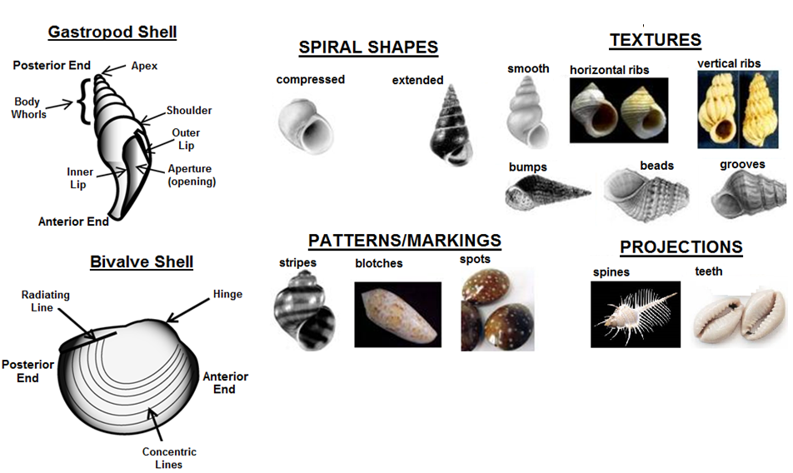
Exercise 6: Finding Species
138

Slide 139
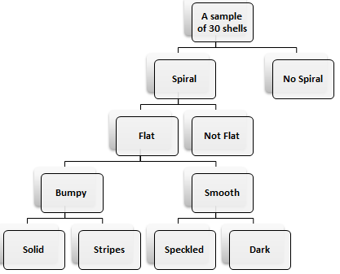
Exercise 6: Finding Species
Pick a characteristic by which to separate the shells into 2 groups.
Write the two variants of the characteristic on the board. Your goal is to make a tree diagram like the one below:
Continue to choose criteria by which to divide your groups, and update your diagram accordingly until each group consists only of shells that are very similar in appearance. As shown in the figure, you may finish partitioning one group of shells before the other.
139

Slide 140
Exercise 6: Finding Species
It will be helpful if you keep track of the numbers of each shell that you place into each group at each split in your hierarchical diagram, as this will facilitate quick location/identification of shells when discussing this exercise in class.
Label each final group on your diagram with the numbers of the shells that belong to that group.
Consult the answer sheet on the inside of the lid of Container C to see that each of your groups consists only of shells from the same species.
Repeat this exercise, using the shells in Container D.
To learn more about species concepts:
To go back to the homepage:
140

Slide 141
Species concepts & “lumpers” vs “splitters”
In the previous exercise, you played the role of taxonomists, deciding where to draw the line between species represented by the samples of shells in your containers.
Many of you may have arrived at different decisions on which shells constituted species in the previous exercise.
This should illustrate to you a fairly important point: taxonomy is a human construct.
Of course, some organisms are more closely related to one another than others, but how scientists break them into various taxonomic groups is a way that humans have devised to help organize closely related organisms together in a way that makes sense.
Defining larger groups (orders, families, classes, phyla/divisions, kingdoms/domains) of organisms that share a common ancestry and traits is a work in progress, and often used as an example of how science is self-correcting, yet what defines a species is also a major topic of debate.
141

Slide 142
Species concepts & “lumpers” vs “splitters”
The big question for many biologists is “where do we draw the line at what constitutes a species?”
There are tons of different concepts that have been used in both historical and modern contexts on what defines a “species”.
Taxonomists use all sorts of criteria on dividing species (morphology, ecology, genetics, ability to mate and produce viable offspring etc.).
It often seems, to many biologists, that there are nearly as many different species concepts as there are types of living organisms!
Ask any two biologists their definition of a species, and you may get very different answers.
On the following slide, you will learn about several different species concepts, as well as different approaches used by taxonomists.
142

Slide 143
Species concepts & “lumpers” vs “splitters”
Most (though not all) biologists define species using the biological species concept.
The biological species concept is one of the first more formal definitions of species, and defines a species as consisting of “a group of interbreeding populations that are reproductively isolated from other such groups” (Mayr, 1942).
This definition is one of the more commonly used ones for a species, though again, many other biologists define species in different ways.
However, there are several other major species concepts that are used by other scientists to define a species. These concepts differ in various ways, but may sometimes agree (though they may often disagree) on when to call two organisms different species.
A little later, you will learn more about some other major species concepts on your own or in teams.
143

Slide 144
Species concepts & “lumpers” vs “splitters”
How taxonomists classify organisms into species usually falls somewhere between two opposite ends of a spectrum of “lumpers” and “splitters”.
A “lumper” would be a taxonomist that groups (lumps) together lots of different organisms in the same species on the basis of several broad similarities that they view as being important characteristics that defines the species.
“Lumpers” generally view species as biological units that may display a very broad range of inter-individual variation.
144

Slide 145
Species concepts & “lumpers” vs “splitters”
On the other hand, a taxonomist who separates organisms into separate species on the basis of lots and lots of smaller details would be known as a “splitter”.
Splitters generally take the following views:
Species may display some important degree of inter-individual variation.
However, species are biological entities that display a lot of important (though often miniscule) highly-conserved traits.
Substantial variation beyond those highly-conserved traits is worthy of giving other organisms their own formal species names.
145

Slide 146
Species concepts & “lumpers” vs “splitters”
Lumping and splitting can both be viewed as having value in different ways, but both “schools of thought” in taxonomy have drawn some criticism.
A quote from George Simpson, a famous paleontologist (a scientist that studies fossils) once provided the following tongue-in-cheek definitions of both:
"Splitters see very small, highly differentiated units – their critics say that if they can tell two animals apart, they place them in different genera … and if they cannot tell them apart, they place them in different species. … Lumpers, on the other hand, see only large units – their critics say that if a carnivore is neither a dog nor a bear, they call it a cat."
146

Slide 147
Species concepts & “lumpers” vs “splitters”
On the following slides, you will play the role of taxonomists, using images of several groups of organisms, many of which you might even see here in Tennessee!
You should work through these groups of organisms in order:
First, you will look at salamanders in the genus Ambystoma.
Next, you will examine lady beetles (ladybugs) in the family Coccinellidae.
Finally, you will examine spiders in the genus Agelenopsis. NOTE: Since spiders often exhibit sexual dimorphism, the images of the spiders in this exercise are females only.
ALSO NOTE: The slides with organism identities are found after each of the picture slides, so don’t click past a set of images until all students have decided how many species they think are present in that set of images!
147

Slide 148
Species concepts & “lumpers” vs “splitters”
For this exercise, you should work in groups of 3-4.
For each group of organisms, examine the numbered pictures of individuals in that group.
Discuss with your teammates the visible characteristics of the individuals, and see if you can come to a consensus decision on how many species are represented by that group of images.
You may find it helpful to draw hierarchical tree diagrams as you did in the previous exercise to help you keep track of traits that you used to separate the organisms into species.
After the entire class is finished sorting a particular group into species, get your teacher, or a scribe from your team, to write on the board how many species you think is in that group.
148

Slide 149
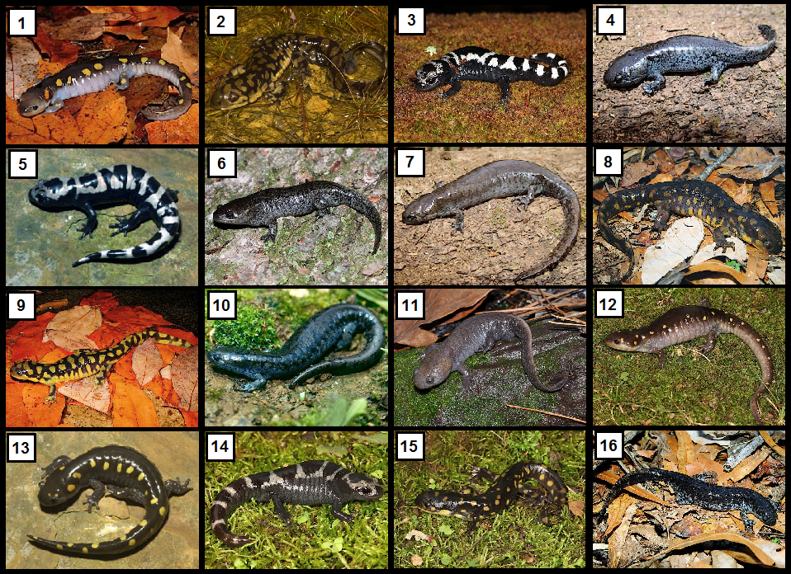
Species concepts & “lumpers” vs “splitters”
149

Slide 150
Species concepts & “lumpers” vs “splitters”
Key to salamander species
Spotted Salamander (Ambystoma maculatum): 1, 12, & 13
Marbled Salamander (Ambystoma opacum): 3, 5, & 14
Mole Salamander (Ambystoma talpoideum): 4, 6, & 11
Smallmouth Salamander (Ambystoma texanum): 7, 10, & 16
Eastern Tiger Salamander (Ambystoma t. tigrinum): 2, 8, 9, & 15
Go to the next slide for additional details on identifying these species!
150

Slide 151
Species concepts & “lumpers” vs “splitters”
This set should have been fairly easy, but a few of the species may have tricked you a little due to some variation:
The Spotted Salamander & Eastern Tiger Salamander have spots.
The coloration of the spots on the Spotted Salamander may be similar in coloration to the spots on the Eastern Tiger Salamander, but the Spotted Salamander’s spots are nearly perfectly round, and not as numerous as those in the Eastern Tiger Salamander.
The Mole Salamander and the Smallmouth Salamander have similar coloration, but the Mole Salamander’s head is much larger in proportion to the rest of its body.
Also note the strong keel (ridge) on the dorsal (upper) surface of the Mole Salamander’s tail.
The Marbled Salamander displays some variation, with the light coloration on its back ranging from dark grey to almost white.
However, its overall pattern and large body size make it practically unmistakeable for any other salamander in the U.S.
151

Slide 152
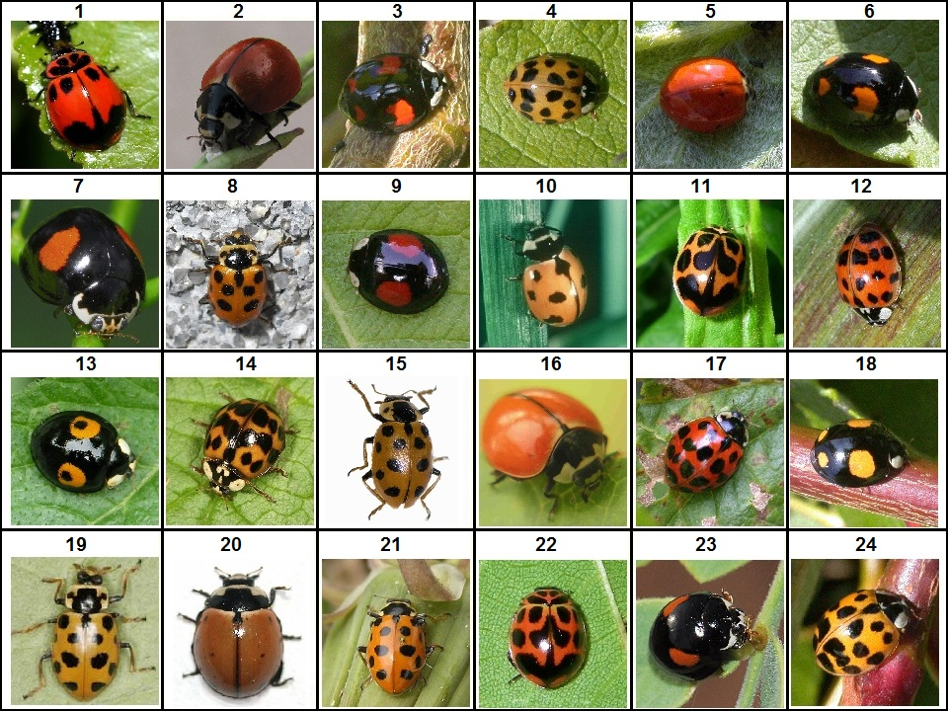
Species concepts & “lumpers” vs “splitters”
152

Slide 153
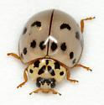
Species concepts & “lumpers” vs “splitters”
Key to Lady Beetle Species
Nine-spotted Lady Beetle (Coccinella novemnotata): 2, 10, 16, & 20
Multicolored Asian Lady Beetle (Harmonia axyridis): 3, 4, 5, 6, 9, 12, 13, 14, 17, 18, & 24
Thirteen-spotted Lady Beetle (Hippodamia tredecimpunctata): 8, 15, 19, & 21
V-marked Lady Beetle (Neoharmonia venusta venusta: 1, 11, & 22
Ashy Gray Lady Beetle (Olla v-nigrum): 7 & 23 (the ones in the exercise are the black and orange form of this species, which also comes in a gray, spotted form like the one pictured below:
153

Slide 154
Species concepts & “lumpers” vs “splitters”
More than likely, your decisions on how to group these lady beetles into species relied solely on the obvious variation in color, pattern, and possibly shape, which are the most commonly used means of identification of beetles within this family.
However, other characteristics such as spines on the legs and feet, as well as grooves on the underside of the thorax, which you were not able to see, are also used to identify genera and species in this family.
Almost half of the lady beetles in the images belong to the species Harmonia axyridis, an invasive species from Asia.
154

Slide 155
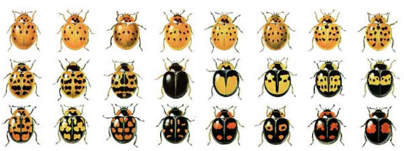
Species concepts & “lumpers” vs “splitters”
Harmonia axyridis is highly variable, displaying an astounding amount of variation in color and pattern.
However, it can often be distinguished by a black “M” shape on the pronotum (the area between the head and the wings), though this shape may be broken up, or obscured by a larger dark blotch.
See the image below for an example of the variation observable within H. axyridis:
155

Slide 156
Species concepts & “lumpers” vs “splitters”
Harmonia axyridis was introduced to the U.S. in CA in 1916, again in CA in 1964 and 1965, in WA from 1978-1982, and throughout Canada and the Eastern U.S. from 1978-1981 as a means of biological control of aphids.
However, this beetle spread throughout the U.S. and Canada rapidly, becoming very common throughout North America by 1994.
This species has actually become a nuisance, often invading homes, where they seek shelter from the cold in the winter.
It has also become problematic by outcompeting many native lady beetle species, such as the other ones pictured in this exercise.
In fact, since the introduction of H. axyridis, Coccinella novemnotata (the Nine-spotted Lady Beetle), has almost disappeared entirely from the eastern U.S.
156

Slide 157
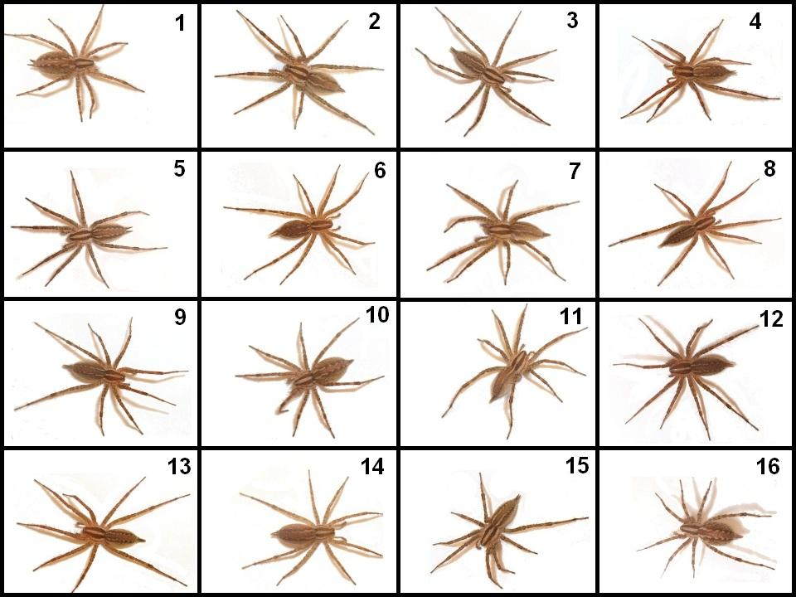
Species concepts & “lumpers” vs “splitters”
157

Slide 158
Species concepts & “lumpers” vs “splitters”
Key to spider species
Agelenopsis aleenae: 3, 5, & 15
Agelenopsis aperta: 1, 10, & 16
Agelenopsis emertoni: 6, 9, 12
Agelenopsis pennsylvanica: 4, 8, 13
Agelenopsis potteri: 14
Agelenopsis spatula: 2, 7, 11
Go to the next slides for more information about these spiders!
158

Slide 159
Species concepts & “lumpers” vs “splitters”
You may have noticed that most of the spiders in these images were very, very similar.
However, taxonomists who specialize in arachnology (the study of spiders) classify members of the genus Agelenopsis into different species based on the shapes and characteristics of male and female reproductive organs, which are not readily visible in these images.
Also, many of these species occur in geographic ranges (and habitats within ranges) that do not overlap, which many warrant as worthy of species status.
These are basically the only means of distinguishing among some species in this genus.
159

Slide 160
Species concepts & “lumpers” vs “splitters”
Traditionally, many spider biologists viewed the shapes of male and female spider genitalia as a sort of “lock and key” model of species.
In such a model, the shape of a male’s pedipalps determines and limits with which females he would be able to mate.
This does appear to be the case in several species of Agelenopsis with overlapping ranges (males of a “species” only mate with females of the same species in those areas).
However, genetic data from a few species suggests that some hybridization within “species groups” composed of several formally described species may occur (Ayoub, Riechert, & Small 2005).
How do Agelenopsis spiders tell each other apart?
It seems to be based on olfactory cues.
In other words, females are thought to release a species-specific pheromone that attracts males of the same species and elicits courtship from them.
160

Slide 161
Species concepts & “lumpers” vs “splitters”
Now that you have examined each of these groups of organisms, answer the following questions via class discussion.
Did the teams differ in the number species they identified in the three groups? If so, which teams would be considered “lumpers,” which would be considered “splitters,” and which teams would fall somewhere in between?
What proportion of the teams could be classified as lumpers, as splitters, or as ‘tweeners’ (in between lumpers and splitters)?
Now organize yourselves into three larger teams (lumpers, splitters, and 'tweeners') based on the number of "species" your smaller teams identified.
Take a few minutes to discuss with your larger team, and then, as a class, your overall reasoning for the number of species that you identified (in other words, why you fell on a particular end, or the middle, of the lumper/splitter spectrum).
161

Slide 162
Species concepts & “lumpers” vs “splitters”
We have already discussed the biological species concept.
Now, take some time to do some research and find some definitions of the following species concepts:
Typological species concept
Ecological species concept
Evolutionary species concept
See if you can find other popular species concepts & their definitions.
Now try to answer the following questions:
Which species concept do you think is the closest to the one you used in dividing up the images in each group into species?
Which species concept seems most sensible to you, & why?
Why is the notion of how one defines a species important?
Go to the next slide for further information!
162

Slide 163
Species concepts & “lumpers” vs “splitters”
Below are definitions of the three major species concepts mentioned in this exercise.
Typological species concept – A species is a certain “type” of organism that looks different than another.
Ecological species concept – A species is a set of organisms exploiting (or adapted to) a single niche (Ridley 1993).
Evolutionary species concept – A species is a single lineage of populations which has its own unique evolutionary history and tendencies (Wiley, 1981).
163

Slide 164
Species concepts & “lumpers” vs “splitters”
In determining which individuals constituted separate species in this exercise, you undoubtedly relied on the typological species concept.
This is because you had no prior information on which of the species represented are capable of interbreeding, nor on the populations from which they came.
The species identifications listed in the keys for this exercise are agreed on by most specialists who work with those particular organisms.
However, further changes in taxonomy are always possible, as more data about those organisms are gathered!
164

Slide 165
Species concepts & “lumpers” vs “splitters”
Why are species concepts important, anyway?
One reason (of many) is that how we define a species has a big impact on when and how conservation efforts are implemented!
The U.S. Endangered Species Act defines a “species” as “any subspecies of fish or wildlife or plants, and any distinct population segment of any species of vertebrate fish or wildlife which interbreeds when mature.”
165

Slide 166
Species concepts & “lumpers” vs “splitters”
This means that specific populations of vertebrates in a particular area, such as grizzly bears, salmon, wolves, etc. can be classified as endangered, even if they are not threatened in other parts of their range, even if they are not described as separate species/subspecies.
However, significant populations of other organisms (invertebrates, plants, etc.) can only be protected in parts of their range where they may be threatened only if they are recognized and formally described as a distinct species or subspecies!
Thus, you can see why species concepts are important to lots of biologists, and why they are a hot topic!
166

Slide 167
Exercise 7: Mystery Shell
Examine the “mystery shell” in Container E.
See if you can figure out what kind of shell it is.
Go to the next slide to see if you were right!
167

Slide 168
Exercise 7: Mystery Shell
The mystery shell is actually the operculum of a snail.
The operculum is a shell door, which many (but not all) snails have.
With this door, the snail is able to close its shell to survive periods of drought and to gain protection against predators.
Snails that live along the seashore are often exposed to air when the tide goes out, and there are many animals that feed on snails, especially birds.
In those situations, an operculum is a valuable adaptation!
168

Slide 169
Exercise 8: Mechanisms Underlying Variation
So far in our exploration of variation, we have seen that individuals vary, and we have learned how to measure variation within a population.
We have also seen that populations vary, and learned to measure the significance of inter-population variation.
We have also learned that individuals can be classified according to their differences via a classification hierarchy.
This exercise introduces the mechanisms that underlie trait variation.
We will use leaves and flowers as examples.
You have also been presented with an additional sample of gastropod shells.
You will use these for an exercise that allows you to explore the concept of variation among species in the context of adaptations.
169

Slide 170
Exercise 8: Mechanisms Underlying Variation
Click HERE to go to Exercise 8a: Variation in Leaves & Flowers.
Click HERE to go to Exercise 8b: Variation in Snail Shells.
Click HERE to go to Exercise 8b.2, which is an open-ended exploration of adaptive variation in snail shells.
170

Slide 171
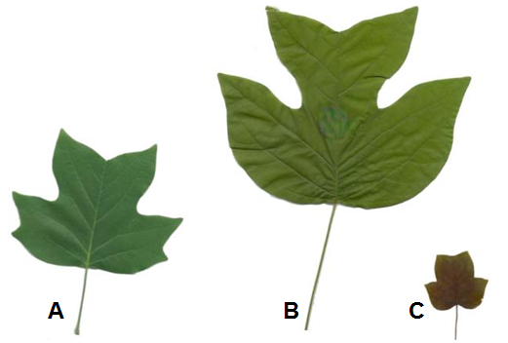
Exercise 8a: Variation in Leaves & Flowers
Examine the leaves below. These leaves were collected from the same tree. In fact, they all came from the same branch.
Note that individual leaves differ in size.
Within a single species, differences in size are frequently associated with differences in age or developmental stage.
As a leaf unfolds from its leaf bud, it gains room to grow larger.
All it needs is time and nourishment in order to grow to the size of a typical mature leaf.
171

Slide 172
Exercise 8a: Variation in Leaves & Flowers
Q1. Can you rank the leaves below from youngest to most mature? Which species of tree did these leaves come from?
CLICK FOR THE ANSWER!
When ranked from youngest to most mature (with younger leaves being smaller than more mature leaves), the order is C, A, B. These leaves came from a Tulip Poplar (Liriodendron tulipifera).
172

Slide 173
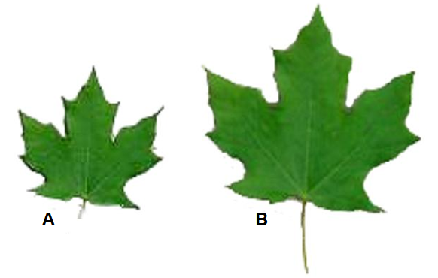
Exercise 8a: Variation in Leaves & Flowers
Now examine the two leaves below.
Unlike the previous leaves, these leaves are both mature, and yet they differ markedly in size.
As you can see, leaf B has a much greater surface area than leaf A.
However, leaf A is actually thicker than leaf B.
These leaves came from different parts of the same tree.
173

Slide 174
Exercise 8a: Variation in Leaves & Flowers
One of the leaves is a sun leaf which was collected from a branch near the top of the tree.
The other leaf is a shade leaf which was collected from one of the lower branches.
The size of these leaves was influenced by their environment and the special needs of trees.
174

Slide 175
Exercise 8a: Variation in Leaves & Flowers
Unlike animals that must consume food to obtain energy, trees obtain energy by making their own food when sunlight hits their leaves.
In order to convert sunlight to usable chemical energy, plants need water, and lots of it.
For example, it is estimated that the typical oak tree (not the type of tree whose leaves are pictured below) needs about 50 gallons of water a day.
Therefore, lack of water and light can severely limit the amount of sugars (food) that a tree leaf can produce.
175

Slide 176
Exercise 8a: Variation in Leaves & Flowers
Because the top of the tree receives more intense sunlight than the bottom of the tree, leaves at the top of the tree are able to produce more food per unit surface area than leaves at the bottom of the tree.
However, leaves at the top of the tree are also subject to greater water loss per unit surface area, also because they are exposed to more sun and wind.
Q2. Why does the top of the tree typically receive more sun than the bottom of the tree?
CLICK FOR THE ANSWER!
The top of the tree typically receives more sun than the bottom of the tree because throughout most of the day the bottom of the tree is shaded by the top of the tree.
176

Slide 177
Exercise 8a: Variation in Leaves & Flowers
Q3. Which type of leaves would you expect to have a greater surface area: shade leaves or sun leaves? CLICK FOR THE ANSWER!
Sun leaves tend to have smaller surface areas than shade leaves.
Sun leaves also tend to be thicker than shade leaves, and have multiple layers of energy producing cells.
Since sun leaves are exposed to intense light that can penetrate multiple cell layers, sun leaves increase energy production & minimize water loss by growing thicker instead of wider.
Shade leaves, meanwhile, do not have to contend with water loss due to exposure to strong wind and light.
Instead, they struggle to obtain enough light. In order to increase their exposure to the sun, shade leaves grow larger surface areas.
Trees can’t consciously alter the way individual leaves grow, so how does this variation occur?
Leaf growth is regulated by multiple genes, some of which are activated or inhibited by light or a lack of light.
177

Slide 178
Exercise 8a: Variation in Leaves & Flowers
Q4. Which of the leaves in the figure below is the sun leaf?
CLICK FOR THE ANSWER!
Leaf A is the sun leaf!
178

Slide 179
Exercise 8a: Variation in Leaves & Flowers
Q5. How much larger is leaf B’s surface area than leaf A’s surface area? Come up with a way to estimate the surface area of the leaves and then use your surface area estimates to perform the following calculations. Calculate how many times larger leaf B’s surface area is than leaf A’s surface area. Calculate the percent difference between the surface areas of leaf A and leaf B.
Go to the next slide for the solution!
179

Slide 180
Exercise 8a: Variation in Leaves & Flowers
180

Slide 181
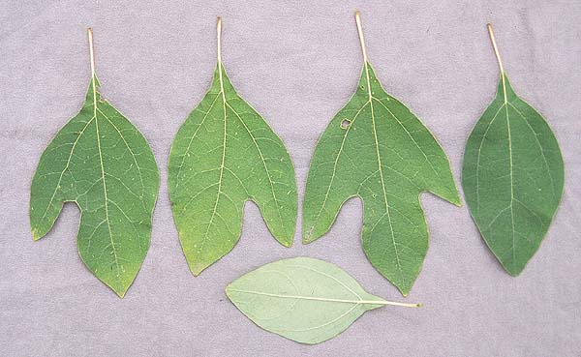
Exercise 8a: Variation in Leaves & Flowers
Examine the leaves below. Note that there are four different leaf shapes:
Elliptical/ovate (balloon or egg-shaped)
three-lobed (two side lobes and one main lobe)
two-lobed, left side
two-lobed, right side
Note that two shapes look like left- & right-handed mittens.
Locate each of the four leaf shapes in the figure.
181

Slide 182
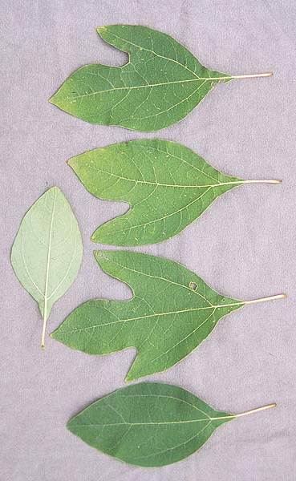
Exercise 8a: Variation in Leaves & Flowers
Sassafras is a tree that produces all four leaf types, often on the same branch!
If a trait, such as leaf shape, varies for genetic reasons, then the distinct variants of the trait are called morphs, and the trait is said to be polymorphic (has many morphs).
Thus, using this new terminology we would say that sassafras exhibits a leaf shape polymorphism with four morphs.
Q6. Can you think of other examples of polymorphisms?
Go to the next slides for examples!
182

Slide 183
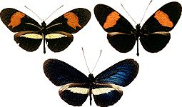
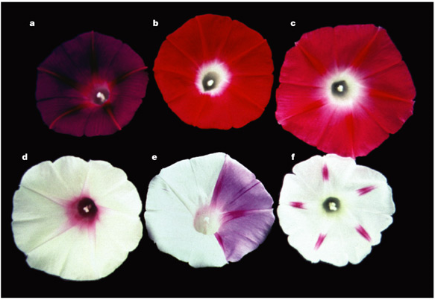
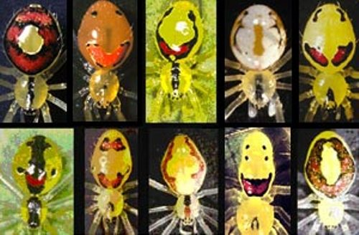
Exercise 8a: Variation in Leaves & Flowers
Other examples of polymorphism include wing colors and patterns within the same species, as in Heliconius butterflies.
Some plant species, including morning glories (Ipomoea sp.) have flower color polymorphism.
Some spider species have different body patterns such as the Hawaiian Happy Face spider (Theridion grallator), that has several different “faces” on its abdomen.
183

Slide 184
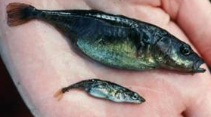
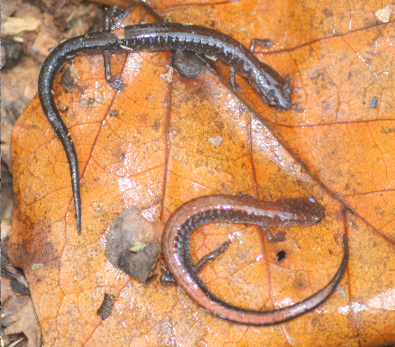
Exercise 8a: Variation in Leaves & Flowers
Some fish species, such as the three-spined stickleback (Gasterosteus aculeatus) are polymorphic with regard to body size and shape.
In these sticklebacks, a larger morph is adapted to benthic habitats (on or near the bottom of aquatic habitats), and a smaller morph is adapted to more limnetic (open-water) habitats.
Many salamanders within the genus Plethodon (like the Southern Red-backed salamander, Plethodon serratus) also have two forms: a dark, unstriped “leadback” form, and a reddish, striped “redback” form.
184

Slide 185
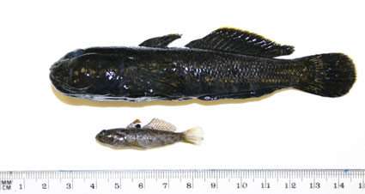
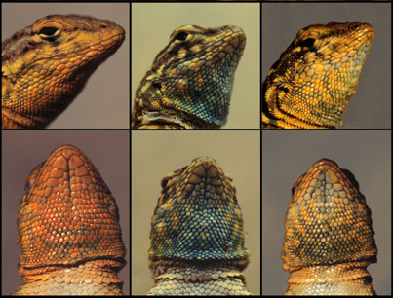
Exercise 8a: Variation in Leaves & Flowers
Some fish (like the round goby, Neogobius melanostomus) and lizards (like the side-blotched lizard, Uta stansburiana) have different male morphs which use different mating strategies.
Large male morphs defend females from other males, but small male morphs look more like females, and are not chased out of larger males’ territories.
These “sneaker” males can then sneak up on females to mate.
These are just a few examples, as polymorphisms can be found in all sorts of other organisms!
185

Slide 186
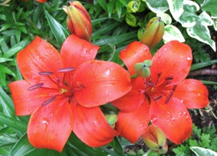
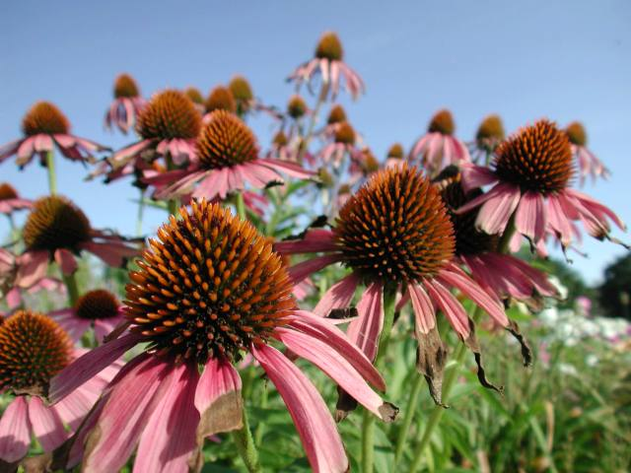
Exercise 8a: Variation in Leaves & Flowers
We have learned that leaves can vary in size and shape for a number of reasons.
Examine the flowers in the figure below.
Do you see many differences between the two flowers of the red lily plant or among the many flowers of purple coneflowers?
Though there are numerous species of flowering plants, within a species, of all the parts of a plant, the flower is the least variable.
We call traits with little inter-individual variation conserved traits.
Go on to the next slides to learn why flowers show little variation within a species.
186

Slide 187
Exercise 8a: Variation in Leaves & Flowers
Flowers house the reproductive organs of the plant.
The male organs are called anthers.
The female organ is called a pistil.
In order to reproduce, flowering plants need animals called pollinators.
Pollinators carry pollen produced by the anthers of one plant to the pistil of another plant.
In pollination, pollinators assist flowering plants with the production of offspring (in the form of seeds).
187

Slide 188
Exercise 8a: Variation in Leaves & Flowers
Pollinators are often species-specific, that is, they pollinate a specific set of species.
For example, hummingbirds may pollinate morning glories but they do not pollinate daisies.
Therefore, it is important that pollinators be able to recognize the flowers of the species they pollinate.
If a pollinator visits the wrong type of flower, then any pollen that it leaves behind is wasted.
Pollen is very costly to make, and is also species-specific.
Seeds will not form if the wrong pollen is delivered to a pistil.
Thus the flowers of a particular plant species have little variation.
188

Slide 189
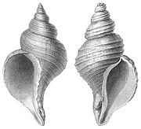
Exercise 8b: Variation in Snail Shells
Are you left-handed or right-handed?
Although they don’t have hands, interestingly, snails also have a form of “handedness,” based on the direction of the opening of their shell.
How can you tell if the spiral of a snail is left-handed or right-handed?
One way is to hold the shell so that the opening is towards you, and the apex (top of the spiral) is pointing upwards.
If the opening is pointed towards your left, your snail has a left-handed spiral.
If the opening is pointed towards your right, your snail has a right-handed spiral.
Left-handed spiral
Right-handed spiral
189

Slide 190
Exercise 8b: Variation in Snail Shells
Another way to determine a snail’s handedness is to hold the shell in the same position, and place a finger in the groove of the spiral at the apex.
Trace this groove with your finger so that you are moving along the spiral path towards the opening in the shell.
If your finger moves in a clockwise path along the groove, your snail has a right-handed spiral.
If the path your finger traveled was counterclockwise, the spiral of the shell is left-handed.
Examine the figure below for an illustration of shells with left-handed and right-handed spirals.
Left-handed spiral
Right-handed spiral
190

Slide 191
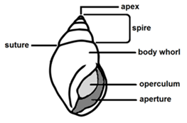
Exercise 8b: Variation in Snail Shells
As a snail grows, it makes its shell “house” bigger to hold its larger body.
The smallest inner coil of the shell is called the apex. It is what remains of the original shell the snail formed before it hatched.
Notice the spiral suture (groove) on the snail’s shell.
If you place your finger in the groove at the shell’s apex, and follow its path, you will see that the shell gets bigger and wider as you move along the groove.
This reflects the way the snail made it shell larger and larger by adding new material as it grew.
191

Slide 192
Exercise 8b: Variation in Snail Shells
Aside from whether they are left- or right-handed, snail shells are also differentiated by their shape and size.
Look at the shells in your sample and notice their many different forms.
Biologists that study shells measure their features so that they can be quantified, or described with numbers.
Today you will play the role of a conchologist (pronounced con-KAH-luh-gist), or scientist that studies shells.
You will measure the shells in your sample so that you can quantify their features.
Examine your sample of snail shells.
You may notice lots of variation amongst these shells, in terms of size, color, texture, etc., but what about shape?
Can you divide your sample of shells into several groups according to their general shape?
192

Slide 193
Exercise 8b: Variation in Snail Shells
Separate the collection of shells into several piles, by placing shells that share similar shapes together.
Try to come up with a name to describe each shape group.
After you have grouped the shells according to shape, examine the shells within each shape group to see how they vary in size.
Position the shells within each shape group according to their apparent size from smallest to largest.
After you have ordered the shells in each shape group according to apparent size, measure each shell’s size.
There is more than one way to measure a shell’s size. Choose one of the possible measures of shell size listed on the following slides, & measure this for each shell.
193

Slide 194
Exercise 8b: Variation in Snail Shells
Number of whorls: This is the number of full rotations of the spiral path of the shell as you move from the apex to the opening. To calculate the number of whorls place your finger on the spiral groove at the apex of the shell and trace its path. Count how many full circles you make as you follow the path to the shell's opening. Estimate partial rotations as you near the opening as fractions of a full rotation (for example, 0.25, 0.5, etc.).
Width and/or height of the aperture (opening)
Shell height: Hold the shell so that the opening is facing you, and the apex is facing upwards. The height of the shell is the straight-line distance from the very bottom to the top of the shell when held in this position.
Shell width: With the shell held in the same position as above, measure the greatest straight line distance across the shell.
Greatest shell circumference: Wrap a piece of string around the widest part of the shell, then straighten out the string and measure the part that wrapped all the way around the shell at this point.
194

Slide 195
Exercise 8b: Variation in Snail Shells
195

Slide 196
Exercise 8b: Variation in Snail Shells
Make a table in which to record each shell’s apparent size ranking (1 being the smallest), and its size measurement. See the table below for an example.
Now try to answer the following question:
Q7. Does your ranking according to apparent size agree with your size measurements? Why might your visual rankings differ than rankings based on your measurements?
Rank | Size measurement (# of whorls)
1 | 1.25
2 | 2.75
3 | 3
4 | 3.5
196

Slide 197
Exercise 8b: Variation in Snail Shells
197

Slide 198
Exercise 8b: Variation in Snail Shells
198

Slide 199
Exercise 8b: Variation in Snail Shells
199

Slide 200
Exercise 8b: Variation in Snail Shells
200

Slide 201
Exercise 8b: Variation in Snail Shells
Suppose that we ranked a sample of five shells according to their whorl numbers and then organized this data in a table like the one pictured below.
To complete the table we need to find the factor by which the whorl number increases from one shell to the next.
Whorl # | Factor by which the whorl number increases (relative to next smaller shell)
1
2
2.5
3.25
3.5
201

Slide 202
Exercise 8b: Variation in Snail Shells
Whorl # | Factor by which the whorl number increases (relative to next smaller shell)
1 | Not applicable
2 | 2
2.5 | 1.25
3.25
3.5
202

Slide 203
Exercise 8b: Variation in Snail Shells
Whorl # | Factor by which the whorl number increases (relative to next smaller shell)
1 | Not applicable
2 | 2
2.5 | 1.25
3.25
3.5
Complete the table above, and then construct a similar table for each of your shell shape groups to show the factor by which the size measurement that you chose increased from one shell to the next.
203

Slide 204
Exercise 8b.2: Thinking about adaptive variation
What can you learn about a snail’s lifestyle (i.e. where it lives, what it eats, how fast it moves, how it defends itself against predators, etc.) by examining the shape of its shell?
Does the shape of a snail’s shell serve a function, help the snail to accomplish particular tasks, or is the shape of the shell the result of the environment in which the snail lives?
Do other traits besides shape give you insight into a snail’s life?
Pick a particular aspect of a snail’s lifestyle that interests you.
Think of at least 2-3 traits that might be related to the lifestyle aspect that you chose. On the following slide are listed a few examples of additional traits that you could measure, in addition to the size-related traits from earlier. You may also measure any other traits that you think might be important.
Measure these traits for each of your shells, and record this data in tables for each shape group, similar to the one below. Use mm for linear measurements.
204

Slide 205
Exercise 8b.2: Thinking about adaptive variation
Other measurements:
Color variation: Some shells are a solid color, while others are variegated. A possible quantitative measure of the variation in shell color would be to count the number of colors on the shell.
Relative height: This is simply the height of the shell divided by its width. This number could actually tell someone about the shape of a shell without them even seeing it! Large values of this ratio indicate that a shell is long and thin, while small values of this ratio indicate that a shell is short and flat.
Go to the next slide for a few other ideas of other measurements.
205

Slide 206
Exercise 8b.2: Thinking about adaptive variation
Whorl expansion rate: This is the factor by which the diameter of the aperture increases with a single rotation. It may be difficult to measure the whorl expansion rate if your shell is intact and the whorls overlap. However, there are many ways to estimate this rate. For example, you could estimate the whorl expansion rate by dividing the height of the visible part of a particular whorl by the height of the visible part of the whorl formed before it (closer to the apex).
Shell angle: This measurement also gives some information about the shape of a shell, and can be measured as the angle formed by the apex of the shell and the most external sutures on the shell.
For an illustration of these measurements, as well as many other informative measures of shell shape, click HERE for images, as well as descriptions on how to measure these traits.
206

Slide 207
Exercise 8b.2: Thinking about adaptive variation
Looking for correlations:
After you have recorded your data, look to see if the traits you measured are correlated.
If one trait is usually large when another trait is large, then there is a positive correlation between the traits.
If one trait is usually small when another trait is large, then there is a negative correlation between the traits.
You may wish to create graphs or plots to better visualize and evaluate whether such relationships are present.
If relationships exist between traits, are these relationships similar or consistent among different shape groups?
Why do you think this may or may not be the case?
207

Slide 208
Exercise 8b.2: Thinking about adaptive variation
Further open-ended exploration:
Using the shell identification guide on the next slides, find the species of snail that made each shell in your collection, and add this information in a new column in your tables.
Use the library or the internet to research these snail species. As you research each snail species, try to answer the following questions:
Are the shell traits that you measured related to the lifestyle aspect that you chose to study?
If so, why might these traits be important?
How do they relate to your chosen aspect of snail lifestyle?
If not, can you find other aspects of the snails’ lifestyles that appear to be related to the traits you chose to measure?
Prepare a brief report of your findings to present to the rest of your class.
208

Slide 209
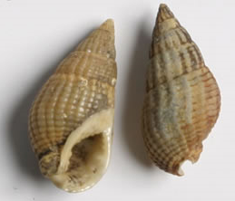
Guide to Snail Shells from Exercise 8
Snails in the genus Nassarius are saltwater snails that typically live in shallow waters. They are scavengers that feed on films of algae and detritus (decaying organic material). They are often seen in marine aquariums, where they help keep the glass clean.
Striped nerite snails are in the family Neritidae. These snails are found all over the world, but are most common in tropical areas. They can live in marine and freshwater habitats, and are most often found in intertidal areas, where they are often exposed to the sun. The majority of species in this family are herbivores that graze on algae, but some also have carnivorous diets, and eat larvae of flies on the roots of mangrove trees.
209

Slide 210
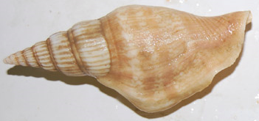
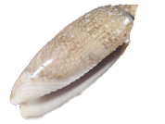
Guide to Snail Shells from Exercise 8
Species in the genus Strombus (the true conchs) live on muddy and sandy bottoms in marine habitats, and range from shallow waters to depths of over 160 feet. They are mostly herbivores, feeding on algae and marine plants. An unusual "leaping" motion is common in this genus, in which the conch digs the pointed end of their operculum (shell door) into the sand or mud, then thrusts its body forward with its muscular foot.
The lettered olive (Oliva sayana) is a species native to North America. This species typically lives near shore, on flat sandy areas, where they capture bivalves and small crustaceans for their carnivorous diet. This species is the state shell of South Carolina.
210

Slide 211
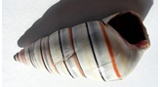
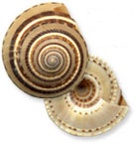
Guide to Snail Shells from Exercise 8
Haitian Tree Snails (Liguus virgineus, sometimes also called candy cane snails) live in trees, where they feed on fungi, algae, and lichens. During dry seasons, they glue themselves to the bark of a tree and seal their shells with the slimy mucus produced by their bodies, and aestivate, which is a term used to describe a period of summer dormancy (similar to hibernation in winter). When the rainy season returns, the snails again become active.
Sundial snails (in the family Architectonicidae) typically live in warm, shallow marine waters, on sandy bottoms. They are found along the coasts of N. & S. America, as well as in the Pacific. Cnidarians such as sea anemones & corals are the preferred food of these snails, which can be pests in marine aquaria.
211

Slide 212
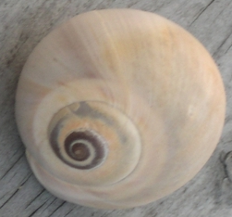
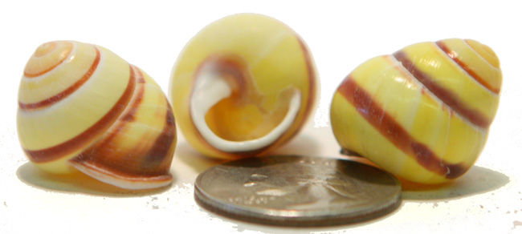
Guide to Snail Shells from Exercise 8
Moon snails (family Naticidae) are a diverse group of ~ 300 species, which can be found in marine waters worldwide, even in the Arctic! They are highly predatory, & actively pursue bivalves, as well as other snails, including their own kind!
Land snails & slugs (formerly classified into the order Pulmonata, no longer considered a valid group) breathe with a single lung. Several species of land snails are polymorphic. Some species vary widely in color, ranging from white to yellow, pink, green, and brown. They may also display variation in the number and intensity of bands on their shells. Different morphs are more common in different habitats. The yellow form is most commonly found in grasslands, where they are well-camouflaged from bird predators. Most land snails & slugs are herbivores that eat grass, leaves, algae, & fruits.
212

Slide 213
Exercise 8b.2: Thinking about adaptive variation
Further open-ended exploration (continued):
Your teacher may wish provide you with a scientific review article on the importance of various aspects of land snail shell shape.
However, when exploring your question, you should consider the following:
The provided article is primarily concerned with land snail species, while some of the provided shells come from aquatic species.
Do you think that shell shape traits may differ in importance between land and aquatic snails? If so, how?
What about different types of aquatic habitats (for example, freshwater versus marine dwelling snails)?
213

Slide 214
Exercise 8b.2: Thinking about adaptive variation
An optional web-based exercise:
Click HERE, and play around with some of the parameters (W, D, and T), clicking the “Draw” button to see their effects.
Can you think of ways to measure your snail shells so that you can estimate these parameters?
Try to see if you can do so for one or more of your shells. If you think you have come up with a way to estimate W, D, and T for those shells, try using those parameters in the model.
Can you produce a shape similar to that of any of the shells in your sample?
214

Slide 215
Suggested Reading
Grades K-3
Find the Seashell - Liza Alexander
Backyard Explorer Kit with Leaf and Tree Guide - Rona Beame & Lionel Kalish (Illustrator)
The Little Yellow Leaf - Carin Berger
Seashells by the Seashore - Marianne Berkes & Robert Noreika (Illustrator)
Leaves Fall Down: Learning About Autumn Leaves - Lisa Marie Bullard & Nadine Takvorian
I Wonder Why Trees Have Leaves and Other Questions About Plants - Andrew Charman
A Simple Brown Leaf - L.J. Davis
Leaf Man - Lois Ehlert
Tell Me, Tree: All About Trees for Kids - Gail Gibbons
The Seashell Song - Susie Jenkin-Pearce & Claire Fletcher (Illustrator)
My Shell Book - Ellen Kirk
We're Going on a Leaf Hunt - Steve Metzger & Miki Sakamoto (Illustrator)
Fletcher and the Falling Leaves - Julia Rawlinson & Tiphanie Beeke (Illustrator)
Autumn Leaves - Ken Robbins
Temperate Decidous Forests: Lands of Falling Leaves - Laura Purdie Salas & Jeff Yesh
Swirl by Swirl: Spirals in Nature - Joyce Sidman & Beth Krommes (Illustrator)
Seashells (True Books: Earth Science) - Ann O. Squire
Look What I Did with a Leaf! (Naturecraft) - Morteza E. Sohi
Leaves - David Ezra Stein
The Leaf That Wouldn't Leave - Trish Trinco & Bryan Langdo (Illustrator)
I Can Name 50 Trees Today!: All About Trees (Cat in the Hat) - Bonnie Worth, Aristides Ruiz (Illustrator), & Joe Mathieu (Illustrator)
Fall Leaves Change Color - Kathleen Weidner Zoehfeld
What Lives in a Shell? - Kathleen Weidner Zoehfeld & Helen K. Davie (Illustrator)
215

Slide 216
Suggested Reading
Grades 4-7
Shell (Eyewitness Books) - Alex Arthur
Exploring Statistics in the Elementary Grades: Book 1, Grades K-6 - Carolyn Bereska, L. Carey Bolster, Cyrilla A. Bolster, Richard Schaeffer, & Rachel Gage (Illustrator)
Variation & Classification (Life Science in Depth) - Ann Fullick
Seashells in My Pocket: AMC's Family Guide to Exploring the Coast from Maine to Florida - Judith Hansen & Donna Sabaka (Illustrator)
Secret Lives of Seashell Dwellers - Sara Swan Miller
The Secret Spiral - Gillian Neimark
A Wasp is Not a Bee - Marilyn Singer & Patrick O'Brien (Illustrator)
The Tree of Life - Peter Sis
Tree of Life: The Incredible Biodiversity of Life on Earth - Rochelle Strauss & Margot Thompson
Animal Kingdom: A Guide to Vertebrate Classification and Biodiversity - Kathryn Whyman
216

Slide 217
Suggested Reading
Grades 7+
Compendium of Seashells: A Full-Color Guide to More than 4,200 of the World's Marine Shells - R. Tucker Abbott & S. Peter Dance
Shells (Smithsonian Handbooks) - S. Peter Dance
Evolution (DK Eyewitness Guide) - Linda Gamlin
Biodiversity - Dorothy Hinshaw Patent & William Munoz (Illustrator)
National Audubon Society Field Guide to North American Seashells - National Audubon Society
The Biodiversity Crisis: Losing What Counts (American Museum of Natural History Books) - Michael J. Novacek (Editor)
The Art of Shelling: A Complete Guide to Finding Shells and Other Beach Collectibles at Shelling Locations from Florida to Maine - Chuck Robinson
Seashells: Jewels from the Ocean - Budd Titlow
A Natural History of Shells - Geerat J. Vermeij
Data, Graphing, and Statistics Smarts! - Rebecca Wingard-Nelson
All Ages
Seashells of the World (Golden Guide) - R. Tucker Abbott, Herbert Spencer Zim (Editor), & George F. Sandstrom (Illustrator)
The World's Most Beautiful Seashells - Pete Carmichael, Leonard Hill, & Tim Ohr (Editor)
Peterson First Guide to Shells of North America - Jackie Leatherbury Douglass & John Douglass (Illustrator)
Seashells - Josie Iselin & Sandy Carlson
National Audubon Society Pocket Guide to Familiar Seashells - National Audubon Society
217

Slide 218
Suggested Reading
Scientific Journal Articles (included on Teacher CD)
Ayoub, N.A., S.E. Riechert, & R.L. Small. 2005. Speciation history of the North American funnel web spiders, Agelenopsis (Araneae: Agelenidae): Phylogenetic inferences at the population-species interface. Molecular Phylogenetics and Evolution 36:42-57.
Bruschi, P., P. Grossoni, & F. Bussotti. 2003. Within- and among-tree variation in leaf morphology of Quercus petraea (Matt.) Liebl. natural populations. Trees 17:164-172.
Cain, A.J. & P.M. Sheppard. 1954. Natural Selection in Cepaea. Genetics 39(1):89-116.
Cotton, P.A., S.D. Rundle, & K.E. Smith. 2004. Trait compensation in marine gastropods: shell shape, avoidance behavior, and susceptibility to predation. Ecology 85(6):1581-1584.
Hugall, A.F. & D. Stuart-Fox. 2012. Accelerated speciation in colour-polymorphic birds. Nature 485:631-634.
Ito, M. 2009. Variation in leaf morphology of Quercus crispula and Quercus dentata assemblages among contact zones: a method for detection of probable hybridization. Journal of Forest Resources 14:240-244.
Oxford, G.S. & R.G. Gillespie. 2001. Portraits of Evolution: Studies of Coloration in Hawaiian Spiders. BioScience 51(7):521-528.
Tang, X. & S. Huang. 2010. Fluctuating selection by water level on gynoecium colour polymorphism in an aquatic plant. Annals of Botany 106:843-848.
218

Slide 219
Links (all underlined text is clickable!)
Archerd Shell Collection – A web-based tour of the Archerd Shell Collection at Washington State University Tri-Cities Natural History Museum. Provides great info on the main classes of mollusk shells, shell development, torsion in gastropods, and more!
The Arthropod Story – Website from the University of California Berkeley’s Museum of Paleontology; contains information on the history and diversity of arthropods, as well as symmetry.
Biology4Kids.com – A great site with information on invertebrate and vertebrate animals, as well as organisms from the other kingdoms of life. The subpages most appropriate for this unit are those for the invertebrates and vertebrates:
Class Gastropoda (Snails and Slugs) - Biodiversity of Great Smoky Mountains National Park - a great website about the gastropod diversity found in our own home state, with lots of information on land snail importance, life histories, anatomy, and identification!
Real Trees 4 Kids – A great site sponsored by the National Christmas Tree Association with TONS of information on trees for kids, broken down into several pages based on grade level, as well as resources for teachers.
The Space Place: Sorting Out Trees in the Forest - Another awesome site from NASA describing how different tree species can even be identified from space with current technology!
eNature: FieldGuides - Excellent online field guide that allows you to enter your ZIP code to access field guides to plants and animals in your area!
The Wonders of the Seas: Mollusks - A brief introduction on mollusk diversity from the Oceanic Research Group.
Learner.org Life Science Session 5 - A great teacher resource and lesson ideas on variation, adaptation, and natural selection.
BBC - Schools Science Clips - Variation - A fun interactive exercise on natural variation for kids ages 6-7.

